Slide 1

CAFP 2027 Resolution Process Overview

Slide 2

Objectives
Explain the resolution process
Identify the essential elements of a strong resolution
Apply best practices in drafting resolutions
Deliver well-structured and thoughtfully crafted testimony
Notes:
Including key steps, timelines, and roles to better understand how resolutions move from idea to adoption.
Such as clear language and background context.
To create proposals that are concise and aligned with organizational priorities.
That clearly conveys key points and supports effective advocacy.

Slide 3
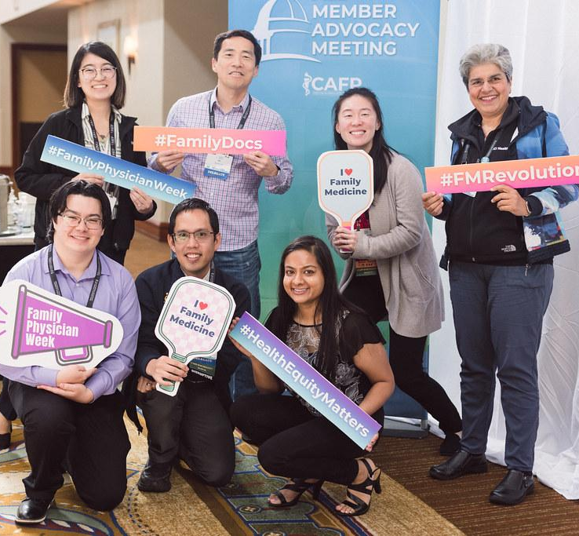
CAFP’s All Member Advocacy Meeting (AMAM) celebrates primary care as the cornerstone of health equity, innovation, and transformative policy, with Family Medicine at the forefront
It focuses on…
🗣️ Advocacy
🏛️ Governance
📜 Policy
Notes:
Empowers members to effectively engage with lawmakers to advocate for change on behalf of family physicians and their patients.
Delegates elect leaders and approve dues and bylaws changes.
Members submit resolutions on important issues for discussion to inform CAFP’s official policy positions.

Slide 4
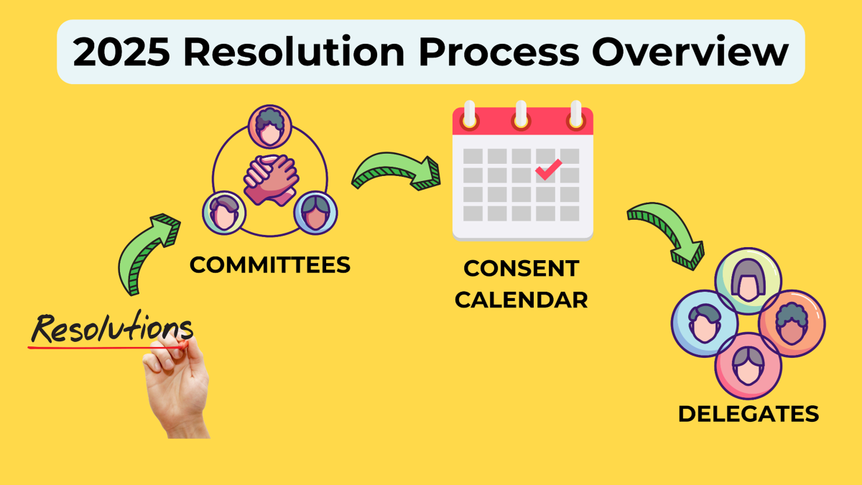
What is a Resolution?
2026 Resolution Process Overview
Forms basis for CAFP/AAFP policy positions and advocacy on issues.
These are CAFP’s and/or AAFP’s “amendments” for their “constitution”, their priorities and principles.
  The policy manual is the compilation of resolutions that have passed over the years (and this can change by passing new resolutions!)
  CAFP and AAFP cannot take policy positions or advocate on issues for which they do not have policy.
Resolution → committee recommendation → AMAM delegate testimony (if extracted) → Board decision → passed → policy manual → academy action
→ not passed → dead
Notes:
(Brent)
JEDI
Governance
Legislative Affairs
Medical Practice Affairs Committee (MPAC)
Finance
Member Engagement
Committee on Public Health & Equity (Justice League)
California Residency Network
Committee on Continuing Professional Development (CCPD)

Slide 5
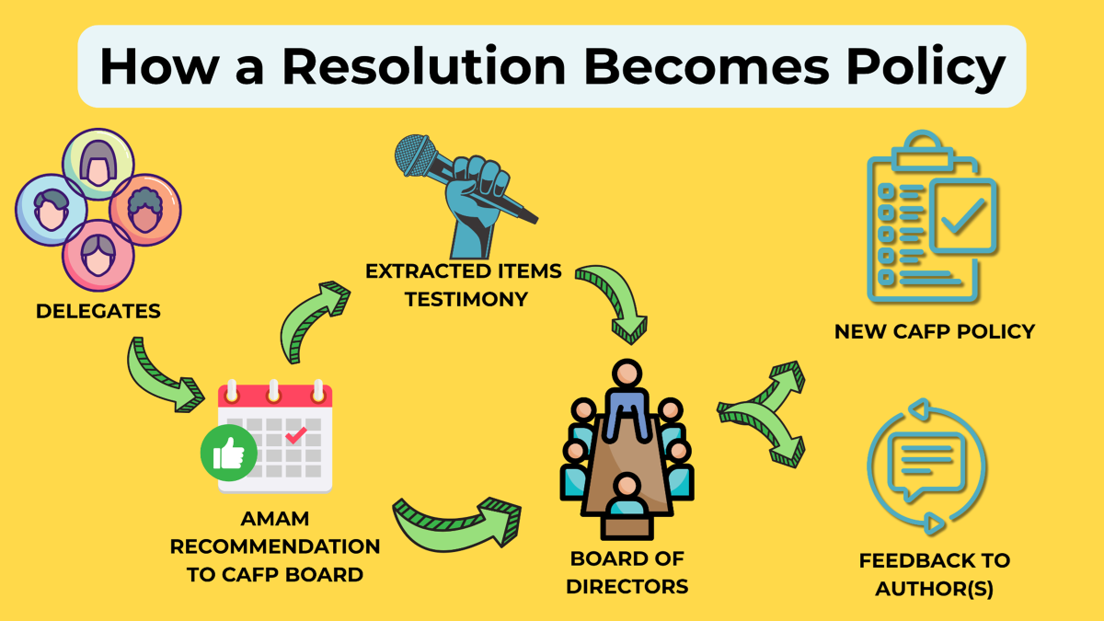
How a Resolution Becomes Policy
Notes:
(Brent)

Slide 6
How does a resolution become CAFP policy?
Consent calendar items are general consensus on the policy direction and don’t require much discussion - usually approved in 1 motion.
Delegates are the only ones who can EXTRACT resolutions from the consent calendar at AMAM. Any CAFP member may provide written or verbal testimony throughout the AMAM weekend.
It’s important that your Delegates know if your chapter wants to provide verbal testimony for any given resolution, so they can extract it from the consent calendar for discussion.
Members submit resolutions online; staff prepare notes
Committees review resolutions and make recommendations to AMAM
Committee recommendations are added to a consent calendar, however, AMAM delegates can extract items for testimony
Items that aren’t extracted go to the Board with committee recommendations (no verbal or written testimony accepted)
Board determines action on each resolution and may submit some for national action at AAFP as appropriate
Notes:
(Brent)
Members submit resolutions by the deadline to the CAFP Board via an online resolution form (https://www.tfaforms.com/5198970)
Staff prepare Speakers and Fiscal Notes, based on current CAFP/AAFP policy
CAFP Committees Review Resolutions and Make a Recommendation to AMAM
Committees Submit Recommendations as a Report
After review by the CAFP Speaker & Vice Speaker, the Committee Reports are Sent to AMAM Attendees Prior to AMAM and Submitted as a Consent Calendar to the Delegates at AMAM
Delegates May Extract Resolutions from the Consent Calendar for Further Discussion at AMAM; All Other Resolutions Not Extracted are Sent to the Board for Consideration as Recommended
AMAM Attendees Offer Testimony on Extracted Resolutions at AMAM
The Board Takes Committee Recommendations and AMAM Testimony into Consideration and Vote to Adopt, Not Adopt, Adopt as Amended, Reaffirm or Refer to Committee for Further Study
Resolutions Submitted for National Action May be Sent to AAFP at the Congress of Delegates in October

Slide 7
Board Determined Resolution Outcomes
Members submit resolutions online; staff prepare notes
Adopt
Adopt and amend
Refer to committee
Not adopt
Refer for national action
Items that aren’t extracted go to the Board with committee recommendations and written testimony
Board determines action on each resolution and may submit some for national action at AAFP as appropriate
Notes:
(Brent)
Members submit resolutions by the deadline to the CAFP Board via an online resolution form (https://www.tfaforms.com/5198970)
Staff prepare Speakers and Fiscal Notes, based on current CAFP/AAFP policy
CAFP Committees Review Resolutions and Make a Recommendation to AMAM
Committees Submit Recommendations as a Report
After review by the CAFP Speaker & Vice Speaker, the Committee Reports are Sent to AMAM Attendees Prior to AMAM and Submitted as a Consent Calendar to the Delegates at AMAM
Delegates May Extract Resolutions from the Consent Calendar for Further Discussion at AMAM; All Other Resolutions Not Extracted are Sent to the Board for Consideration as Recommended
AMAM Attendees Offer Testimony on Extracted Resolutions at AMAM
The Board Takes Committee Recommendations and AMAM Testimony into Consideration and Vote to Adopt, Not Adopt, Adopt as Amended, Reaffirm or Refer to Committee for Further Study
Resolutions Submitted for National Action May be Sent to AAFP at the Congress of Delegates in October

Slide 8
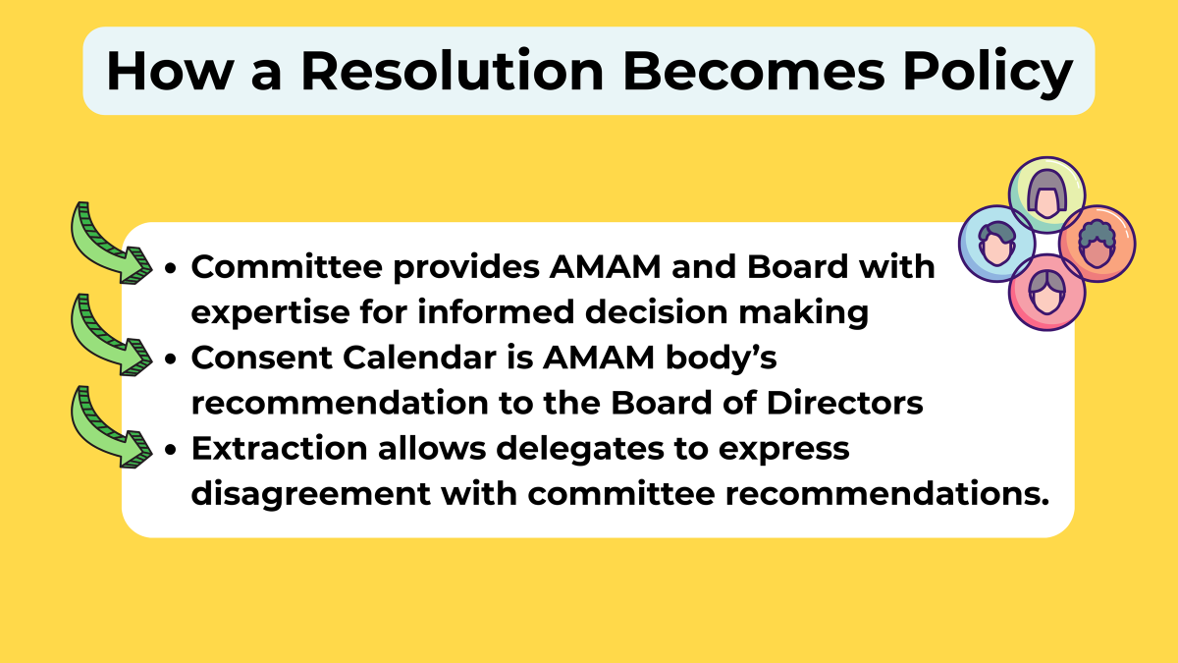
How a Resolution Becomes Policy
Committee provides AMAM and Board with expertise for informed decision making
Extractions with verbal or written testimony allow delegates to express disagreement or add information to committee recommendations
Consent Calendar is AMAM body’s recommendation to the Board of Directors.
Notes:
(Brent)

Slide 9
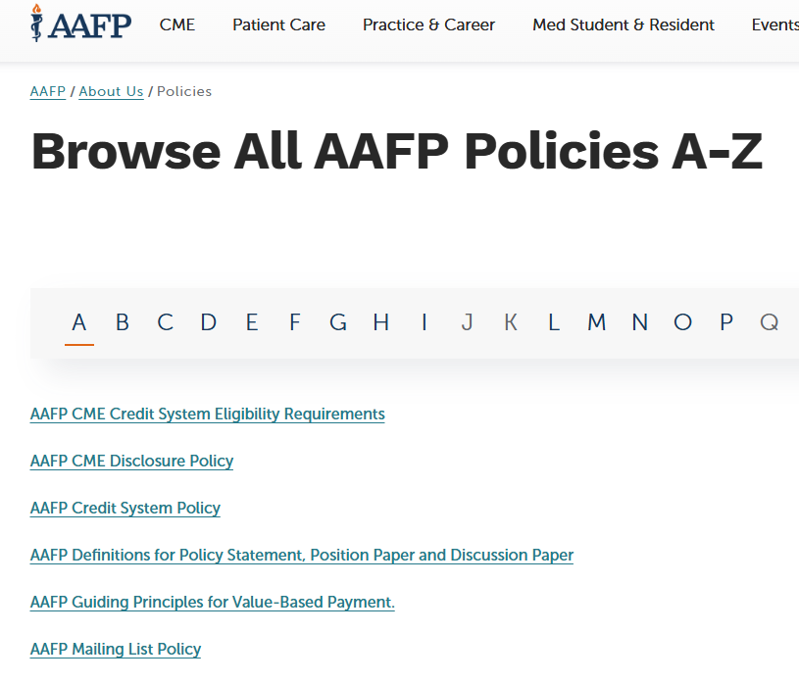
How to Find CAFP and AAFP Policy
CAFP
AAFP
familydocs.org/policy
Under “Current Policy” click “Download” to download our current Policy Compendium PDF
Policies are organized by topic so you can click on the applicable topic or search the document for relevant policy
https://www.aafp.org/about/policies
Notes:
(Brent)

Slide 10
HOW TO WRITE
A STRONG RESOLUTION
Notes:
(Erika)

Slide 11

✅ Purpose
Guide and develop CAFP policy
Not direct strategic priorities, activities or operations
📜 Policy Alignment
Should not be covered by existing CAFP/AAFP policy
General Principles for Resolutions
Notes:
https://www.familydocs.org/wp-content/uploads/2025/09/25.ADM_.CAFPPolicyManualUpdate.9.23.25.Current-Version.pdf

Slide 12
General Principles for Resolutions (continued)
🚫 No Specific References
Avoid naming legislation, programs, products, or services
Focus on underlying issues for long-term applicability
🎯 Scope & Authority
Must fall within CAFP’s scope and authority
📌 Strategic Fit
Relevant to CAFP’s current strategic goals
Should not require outsized resources beyond those goals

Slide 13
How to Write a Resolution
💡 Get Inspired
What makes you mad?
What do think all FM docs should care about?
📖 Review Current Policy
CAFP & AAFP Policy Manuals
📑 Review Guidelines
CAFP submission rules
✍️ Start Writing
Begin drafting your resolution
🎯 Identify Your Ask
Start with RESOLVED clauses
📚 Compile the Evidence
Use brief WHEREAS clauses
Add relevant citations
📬 Submit
By December 7, 2026 3:00 p.m.
Questions? cafp@familydocs.org (415) 345-8667
Notes:
{Edit}

Slide 14
How Do You Write a Resolution?
“Whereas” Statements
Explain the rationale for the resolution and identify a problem or need for action;
Provide relevant research/data
Address its timeliness or urgency and its effects on member constituencies, CAFP, and/or the public at large
Indicate whether the proposed policy or action will alter current CAFP or AAFP policy.
Limit the number of “whereas” statements to the minimum required to provide reasonable support for the “resolved” clause(s).
Limit the use of adjectives or qualifying adverbs which are considered “editorial opinion.”
“Whereas” statements of resolutions do not carry forward once a resolution is adopted

Slide 15
How Do You Write a Resolution?
“Resolved” Statements
Each “resolved” clause must stand on its own as
“Whereas” statements of resolutions do not carry forward
Clauses should not refer to other “resolved” clauses or the “whereas” statement(s)
Resolved clauses should not reference any specific legislation, program, service, or product.
Call for only one action in each “resolved” clause. If there are two or three related actions being proposed, write a separate “resolved” clause for each.
New! Resolutions are limited to three resolved statements each
New! Do not include AAFP referrals in resolved statements. Instead, check the box in the submission form to request your resolution be considered for AAFP referral
All “resolved” clauses must be related to the central subject of the resolution and clearly state a policy position
Notes:
(Erika)

Slide 16
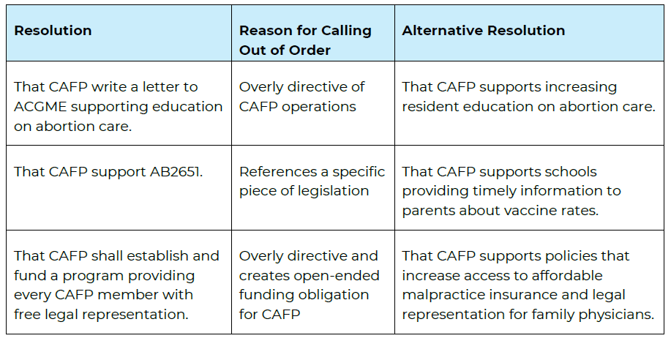
Examples of Out of Order Resolutions
Notes:
(Erika)

Slide 17
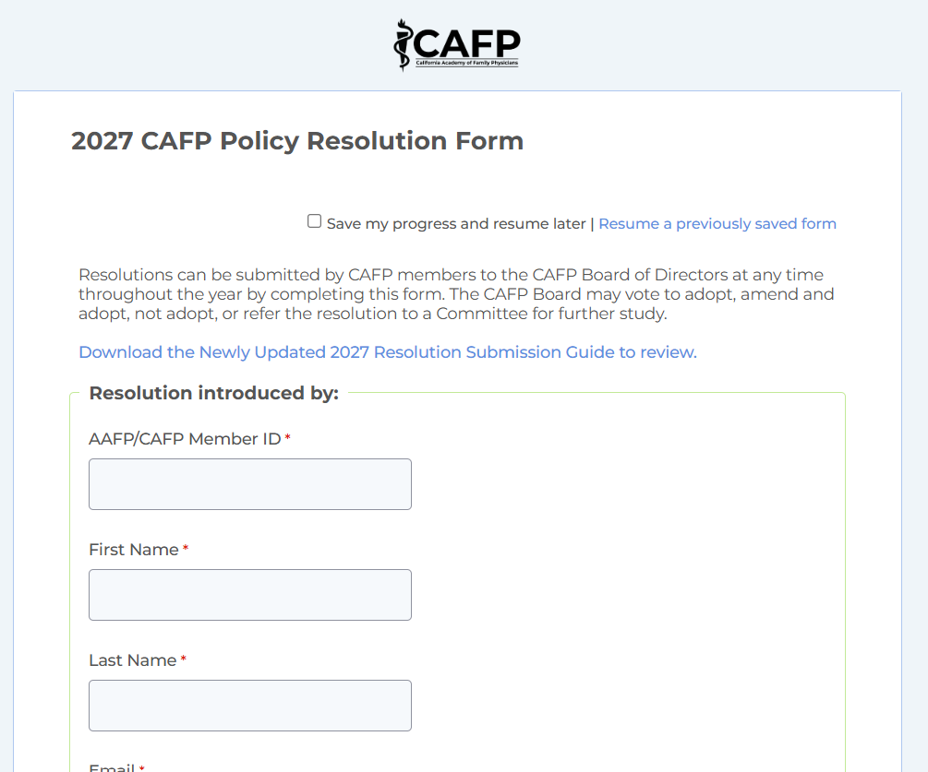

2027 Submission Form
https://www.tfaforms.com/5227255
Notes:
(Brent)

Slide 18

But can a resolution really do anything?

Slide 19
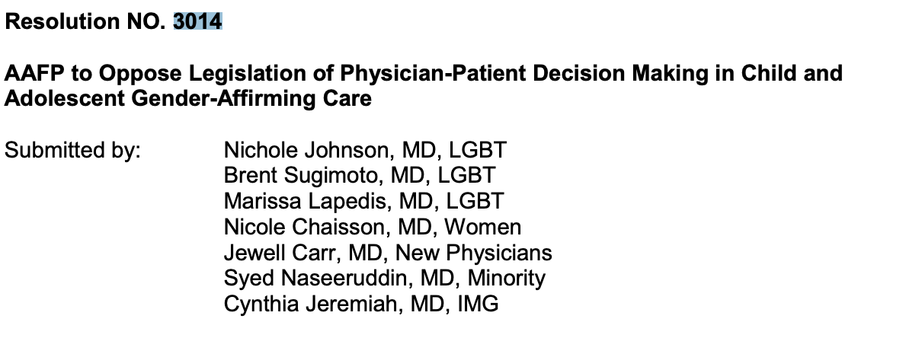
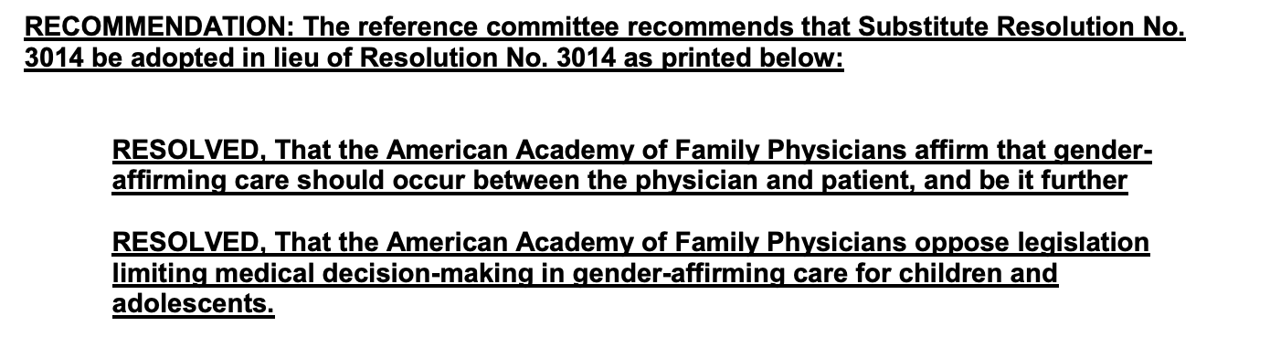
For example…
Notes:
Heres an example of a resolution that was written by a state chapter, was sent to the AAFP national conference of constituency leaders, NCCL and then passed by the delegates at AAFP’s Congress of Delegates

Slide 20
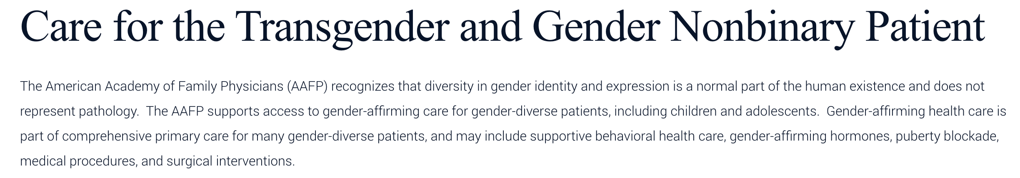
Resolution Becomes Policy
Notes:
After it passed, AAFP made and published the policy

Slide 21

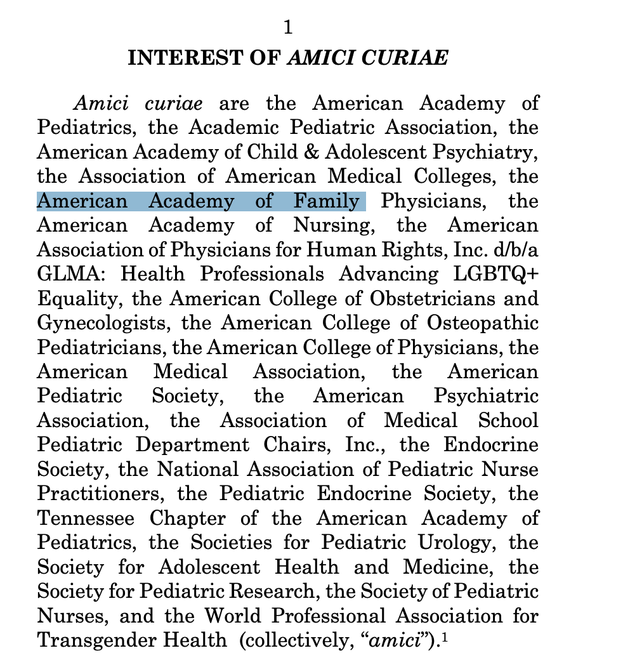
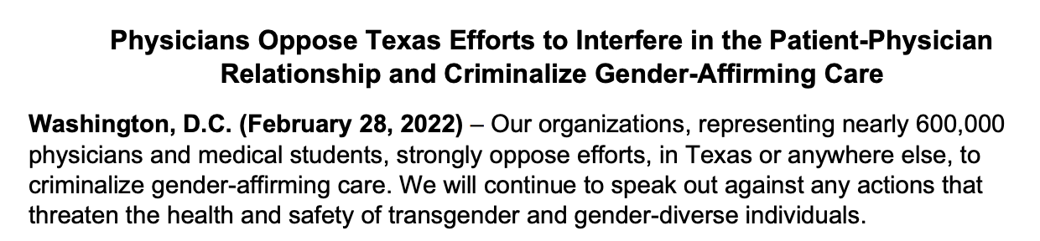
Policy Becomes Action
Notes:
When there was a relevant court case (and like the trans case now in supreme court), AAFP can take a policy stance because of the policy it has on file.
They did so when Texas first banned it, and they took it in September, joining 20 medical organizations filing a brief against the ban on GAC
Had there not been a resolution that went to national level in support of gender affirming care, AAFP could not have joined the other organizations standing against this legislation

Slide 22
HOW TO PROVIDE TESTIMONY

Slide 23

Overview of Testimony
Testimony is responding to a Committee’s recommendation, NOT the original resolution
Two Forms of Testimony
Written Testimony:
Formal written testimony can be submitted for Board consideration throughout AMAM, due by the end of the weekend
On extracted resolutions ONLY
Verbal Testimony:
Presenting support or opposition to a particular resolution at AMAM in front of peers
Good opportunity to express strongly held beliefs, share personal stories or include data about a particular topic
Notes:
(Brent)

Slide 24
Why is Testimony Important?
📣 Direct Influence
Express opinions to decision makers (CAFP Board of Directors), potentially swaying votes.
❤️ Humanize Policy
Share personal/patient stories to make issues relatable and compelling.
📊 Provide Expertise
Offer data, studies and expert perspectives to strengthen policy.
🔍 Ensure Transparency
Reveal the perspectives of those affected most, increasing accountability.
📚 Fill Knowledge Gaps
Bridge research and policy to support informed decisions.
🌎 Shape Policy Focus
Help decision makers identify the most important issues.
🚀 Advocacy & Awareness
Raise visibility of your policy positions and practice your advocacy skills.

Slide 25

Introduction
Name, Delegate/General Registrant, School/Residency Program, District, Speaking on behalf of…(self, student/resident council, chapter, etc.)
I am speaking IN SUPPORT/AGAINST this resolution…
Provide examples in your clinical experience or lived experience that bolster the evidence provided in the WHEREAS sections.
Note statistics/data if relevant
Strength of testimony comes from your unique experiences and perspective. Stories!
Keep your testimony short and concise - you will have very limited time.
Anatomy of a Great Verbal Testimony
Notes:
(Interactive - Invite people to testify)

Slide 26
In Summary:
✅ Resolutions
Shape CAFP’s policies and advocacy priorities
Must follow guiding principles (scope, alignment, no specific legislation, strategic fit)
✍️ Writing Resolutions
Start with RESOLVED clauses
Support with concise WHEREAS clauses and evidence
Submit by Monday, December 7 at 3:00 p.m.
🗣️ Testimony
Delegates may extract resolutions for testimony
All members may provide oral or written testimony on extracted resolutions
🌎 Impact
Amplify family medicine’s voice
Influence policy, governance and advocacy at state and national level
Notes:
Members submit resolutions by the deadline to the CAFP Board via an online resolution form
Staff prepare Speakers and Fiscal Notes, based on current CAFP/AAFP policy
CAFP Committees Review Resolutions and Make a Recommendation to the Board
Committees Submit Recommendations as a Report
After review by the CAFP Speaker & Vice Speaker, the Committee Reports are Sent to AMAM Attendees Prior to AMAM and Submitted as a Consent Calendar to the Delegates at AMAM
Delegates May Extract Resolutions from the Consent Calendar for Further Discussion at AMAM; All Other Resolutions Not Extracted are Sent to the Board for Consideration as Recommended
AMAM Attendees Offer Testimony on Extracted Resolutions at AMAM
The Board Takes Committee Recommendations and AMAM Testimony into Consideration and Vote to Adopt, Not Adopt, Adopt as Amended, Reaffirm or Refer to Committee for Further Study
Resolutions Submitted for National Action May be Sent to AAFP at the Congress of Delegates in October

Slide 27

Upcoming Important Dates
10/14/26 – Speakers Office Hours 7-7:30
12/07/26 - Resolution Submission Deadline
01/12/27 - Delegate Submission Deadline
04/3/27 – 04/4/27 - All Member Advocacy Meeting
04/5/27 - Lobby Day

Slide 28
Questions?

