Slide 1
Implementing the Trauma-Informed Tips Series
Andi Fetzner, PsyD
Lori Chelius, MBA/MPH
Co-founders, Origins Training & Consulting
Notes:
Lori
Welcome
Excited to partner with the California Academy of Family Physiciians on the Trauma-informed Tips workshop series
This video is designed to support you as you implement this series
In this video, We will review the context for creating this series, the materials you have access to, and then review some general tips in terms of implementing the series. At the end of this, we will do an abbreviated run-through of a sample tips workshop to help bring it all together
Before we do any of that, going to hand it over to Orgins Co-FOunder
Andi - mindfulness
Facilitator Notes:
You may want to start with a connection activity. If the workshop is virtual, a “share-in-the-chat” can help set the tone for connection and interaction.
Facilitator can provide an introduction of themself and invite participants to share.
Depending on size of group, you might want to consider having participants break into small groups for introductions.
Share the overall goal of the workshop and offer context within which it is being provided.
Resources:
Facilitator Guide
Priya Parker- The Art of Gathering: How We Meet and Why It Matters- https://www.priyaparker.com/book-art-of-gathering

Slide 2
Trauma-informed is a strengths-based approach to organizational culture that recognizes how stress affects people, promotes tools and practices to increase resilience, and encourages opportunities for safety and connection.
This approach starts with each of us.
~Origins Training & Consulting, 2023
Notes:
To provide context, Share definition of
This approach applies both externally in terms of patient care and also internalyl in terms of how we interact with our fellow staff and colleague.
This approach is ultimately about creating culture. A culture that increases safety and connection and decreases stress.

Slide 3
Principles of a Trauma-Informed Approach
1. Safety
2. Trustworthiness & transparency
3. Peer support & mutual self-help
4. Collaboration & mutuality
5. Empowerment, voice, & choice
6. Strengths-based
7. Cultural, historical, & gender humility
Adapted from SAMHSA
Notes:
Lori
Facilitator Notes:
The trauma-informed principles help operationalize this approach by offering a way to translate the key concepts of toxic stress, trauma, and resilience into action. These principles, adapted from the Substance Abuse and Mental Health Services Administration (SAMSHA), include
Safety
Trustworthiness and transparency
Peer support & mutual self-help
Collaboration and mutuality
Empowerment, voice, and choice
Strengths-based
Cultural, historical, and gender humility
Resource:
SAMHSA’s Concept of Trauma and Guidance for a Trauma-Informed Approach: https://store.samhsa.gov/sites/default/files/d7/priv/sma14-4884.pdf

Slide 4
What is it?
Facilitator guide
Slides
Sample emails
Handout
Notes:
Lori
Each workshop in this Series is
organized around a trauma-informed principle (so 7 workshops) and offers three practical tips for bringing that principle to
life.
The materials include:
FACILITATOR GUIDE with general facilitator tips and ideas for engaging participants in discussions and activities.\
SLIDES with facilitator notes and additional resources.
SAMPLE EMAILS to share with participants after workshops to reinforce tips.
HANDOUT on understanding stress, trauma, and resilience to support a shared language.
VIDEO to support facilitators on how to implement the series. Reviewing here but can finf more detail in facilitato guid
Hand it back to Andi to review some tips for implementing the series

Slide 5
General Facilitation Tips
Send out info in advance
Welcome participants
Connect first
Remember: TIC starts with you
Start with grounding/mindfulness
Establish and review agreements
Set virtual guidelines
Accommodate different learning styles
Own mistakes
Pace the workshop
Build in breaks
Practice a closing activity or ritual
Share resources
Notes:
Andi
Send out info advance
TIC starts with you
Agreements
Some might be experienced, some not, some have some experience
be aware of biases, stay grounded

Slide 6
General Activity Tips
Collaborate on agreements
Remember that participation is voluntary
Provide structure to support agreements
Consider accessibility and cultural concerns
Create predictability and offer choice
Practice mindfulness and grounding
Materials include prompts and examples including:
  Small group discussion
  Large group discussions
  Anonymous sharing
Notes:
Andi- connected to tips, ways to bring them to life
Keep agreement
Menti, jamboard-
Chat feature

Slide 7
Tips for Participant Engagement
Small group/breakout
Anonymous participation
Popcorn
Alphabetical order
Brainstorming
Notes:
Andi
Online tools

Slide 8
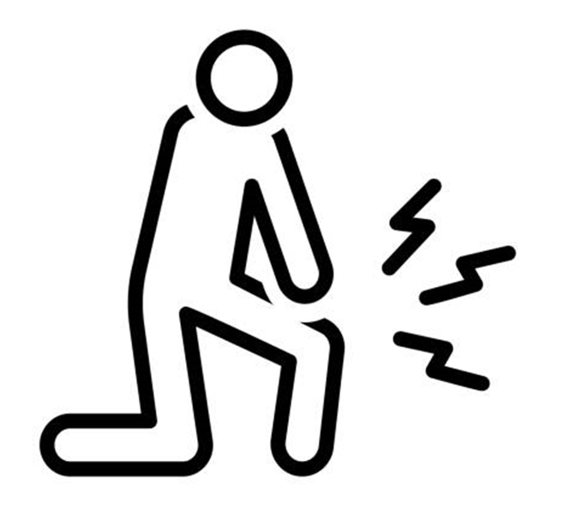
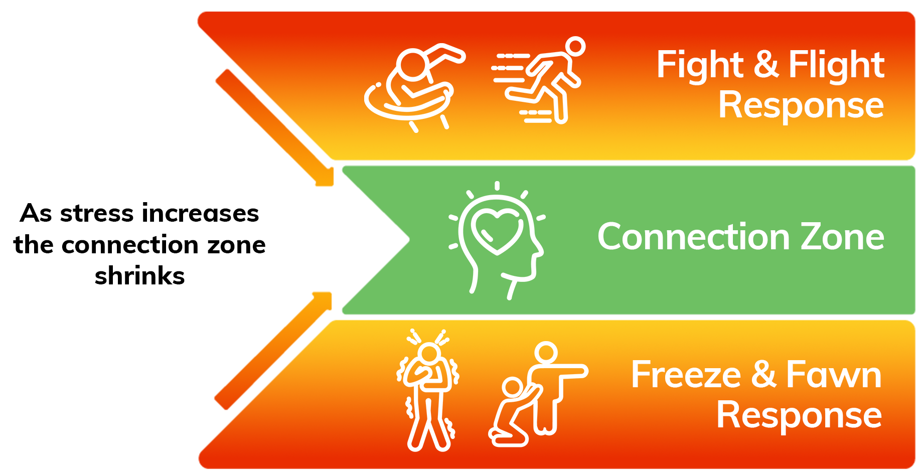

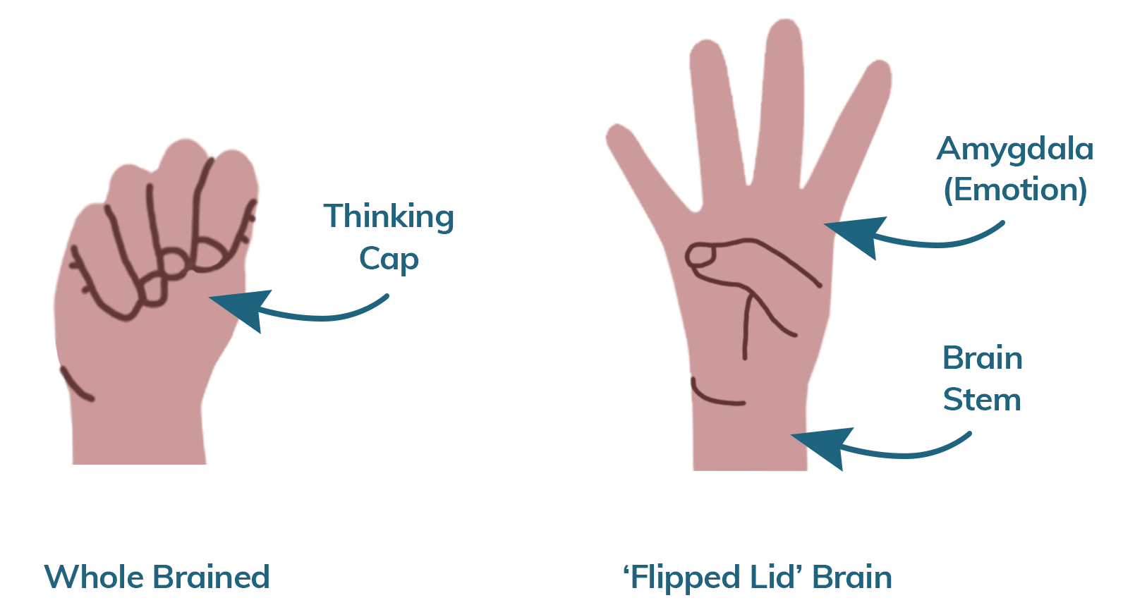

Notes:
Andi
Handout
Talk through langauge

Slide 9

What to Expect
  Workshop structure
    Define principle
    3 tips
      Why?
      Example
      Engagement/practice
  Supporting emails
Notes:
Lori
Facilitator Notes:
Shifting gears to walk through a sample workshop. For the purposes of this video, we will be focusing on safety. We will go through 2 of the tips for this particular workship
Creating predictability is one way to create safety so we always start each workshop with an overview of what to expect.
Each workshop focuses on one trauma-informed principle and follows a similar format. This structure includes:
A definition of the principle. In addition to offering a formal definition, you can invite participants to share what that principle means to them.
Three practical tips to support the implementation of that principle. Each tip will include an exploration of why that tip supports the principle, examples of how to put the tip into action, and an activity to allow participants to practice implementing the tip. ENGAGEMENT IS KEY, always optional
Once the workshop has concluded, participants will receive an email or an email series to reinforce the tips

Slide 10
Principles of a Trauma-Informed Approach
1. Safety
2. Trustworthiness & transparency
3. Peer support & mutual self-help
4. Collaboration & mutuality
5. Empowerment, voice, & choice
6. Strengths-based
7. Cultural, historical, & gender humility
Adapted from SAMHSA
Notes:
Lori
Facilitator Notes:
We also find it helpful to reinforce the list of trauma-informed principles and remind participants of the broader context of the series. We like startiung with safety because it is a foundational principle
This slide expands on a trauma-informed approach by reviewing SAMHSA’s trauma-informed principles. These principles can help you apply the key concepts of toxic stress, trauma, and resilience to the real world.
These principles apply both externally in terms of patient care and also internally in the organization.
A trauma-informed approach is rooted in culture and is not a checklist of activities. These principles serve as the foundation for creating that culture and help you put many of the concepts in this training into action.
Organizations can also adopt a trauma-informed approach to include the integration of trauma-informed principles. An example of this would be employee celebrations to support culture-building, hiring people from the communities they serve, time off for mental health, or even just starting meetings with a mindfulness practice.
You can learn more about each these principles in SAMHSA’s Concept of Trauma and Guidance for a Trauma-Informed Approach.
Resource:
SAMHSA’s Concept of Trauma and Guidance for a Trauma-Informed Approach: https://store.samhsa.gov/sites/default/files/d7/priv/sma14-4884.pdf

Slide 11
Safety
Throughout the organization, staff and the people they serve, whether children or adults, feel physically and psychologically safe; the physical setting is safe and interpersonal interactions promote a sense of safety. Understanding safety as defined by those served is a high priority.
Source: SAMHSA (2018)
Notes:
Lori
Facilitator Notes:
This definition is from the Substance Abuse and Mental Health Services Administration.
You may want to highlight the concepts of physical and psychological safety.
Each person has different boundaries and limits as to what they experience as safe.
Perceptions of safety are impacted by each person’s unique life experiences and current stressors.
As with all of the principles, you may want to remind participants that the principles applies both externally in terms of patients care and also internally within the organization.
Resource:
SAMHSA’s Concept of Trauma and Guidance for a Trauma-Informed Approach: https://store.samhsa.gov/sites/default/files/d7/priv/sma14-4884.pdf

Slide 12
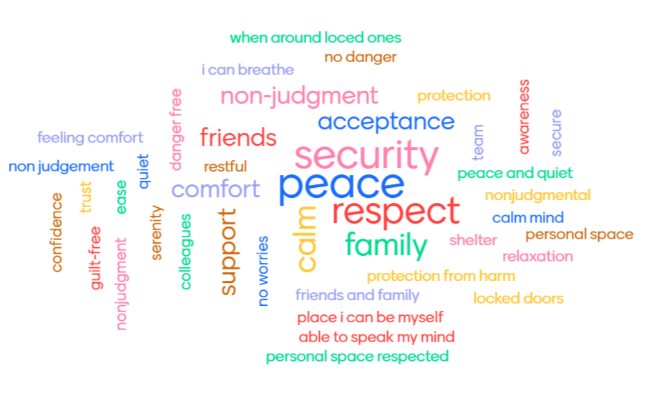
What does safety
mean to you?
Notes:
Lori
Facilitator Notes:
We often . This can serve two purpose - 1) to get a sense of what safety means to participants and 2) an opportunity to set the tone for for engagement
We often create a word cloud like you can see here. You may want to include w the emails you send out after the workshop.
The facilitator can guide an activity to encourage discussion on what safety means to participants. See activity tools for support.
Depending on time, a large group discussion or activity can help achieve the goal of understanding this principle as defined by the group.
The information collected can be used in the email sequence and shared with participants.
Activity Tools:
Google jamboard: https://jamboard.google.com/
Menti: https://www.mentimeter.com/

Slide 13

“Safety is not the absence of threat, it is the presence of connection.”
~Gabor Maté,
Physician & Author
Notes:
Lori
Facilitator Notes:
For safety, we also like to offer this more informal definition by Gabor Mate .
We like this definition because When we increase safety and connection and decrease stress, we are practicing a trauma-informed approach.
When we increase safety and connection and decrease stress, we are practicing a trauma-informed approach. Consider this as we move through the tips in this workshop.
Gabor Maté, a Canadian physician and author specializes in understanding intergenerational trauma, defines safety as not the absence of threat but the presence of connection.
When we increase safety and connection and decrease stress, we are practicing a trauma-informed approach. Consider this as we move through the tips in this workshop.
Resources:
Gabor Maté- https://www.wholehearted.org/title/the-power-of-connection/

Slide 14


Tip 1: Incorporate movement
Notes:
Andi
Facilitator Notes:
Why?
Incorporating movement before, during, and after a potentially high-stress experience is important to metabolize stress hormones internally and to help de-escalate the situation externally.
When the mind has awareness of the body, we can move with intention through the stress cycle (you may want to use the example of a glitter jar in the video below ) so that we don’t freeze or explode on those around us (like a volcano).
Those sensations of tension in the body exist for a purpose–to keep us safe!
Movement helps us complete the stress cycle.
Resources:
Mindfulness jar video- https://www.youtube.com/watch?v=GHpwzNyBpAw
Brené Brown, Emily Nagoski and Amelia Nagoski on Burnout and How to Complete the Stress Cycle- https://brenebrown.com/podcast/brene-with-emily-and-amelia-nagoski-on-burnout-and-how-to-complete-the-stress-cycle/

Slide 15

How can we do it?
Walking meetings
Get up and stretch (or jump around!)
Offer high 5’s, elbows
Notes:
Andi
Facilitator Notes:
How can we do it?
Walking meetings: Whether in-person or virtual, walking during meetings can be a helpful way to get the blood flowing and to create a healthy workplace culture. Identify one way you can incorporate this into your weekly routine.
Get up and stretch (or jump around!): For some of us, jumping is not an option and that’s ok. In between calls or even as a way to start a meeting, try stretching your arms to the sky, touching your fingers to your toes, or shaking out any tension and notice any changes you feel before and after.
Offer high 5’s, elbows: We are all in this together. Offering high 5’s or elbow taps throughout the day is a great way to get in your body and to connect with those around you. Challenge yourself to do this at least once a day.
Acknowledge that modifications may be needed to accommodate any physical limitations of participants.
Resource:
Getting Started with Mindful Movement- https://www.mindful.org/getting-started-with-mindful-movement/

Slide 16
Activity: shaking 8
Count 1-8 while shaking your left hand then right hand then left foot, then right foot. e.g.
Left hand shake - "1,2,3,4,5,6,7,8"
Right hand shake - "1,2,3,4,5,6,7,8"
...then left foot and right foot
You do the sequence again but this time count up to 7.
You repeat this decreasing every time and until the last set of 1 when you shake your whole body out.
Notes:
Andi
Facilitator Notes:
In this activity, you will lead participants in practicing incorporating movement.
Invite participants to count with you.
Remind participants that they can choose to participate in whatever capacity they desire and are able. Offer accommodations like the option to sit rather than stand.
Activity Tools:
Large group discussion (see tips)

Slide 17

Tip #2: Set (& hold) healthy boundaries
Notes:
Lori
Facilitator Notes:
Why?
The quote by Prentis Hemphill, “Boundaries are the distance at which I can love you and me simultaneously”
A boundary can help us define how we are able to stay in relationship with another person and maintain a safe and healthy connection with those around us.
Stay in connection - Different roles - front desk, grocery story
Doesn’t mean you have to be best friends
Setting (and holding) healthy boundaries can look like a collaborative process including asking for preferences and permission.
It can be flexible and it can be firm.
It can help people feel heard and honored.
As part of this, It is important to recognize the difference between real and perceived emergencies.
Resource:
Prentis Hemphill- https://prentishemphill.com/

Slide 18

How can we do it?
Identify your boundaries
Communicate your boundaries (clear is kind)
Hold your boundaries
Notes:
Lori
s
How can we do it?
Identify your boundaries: Before we can set a boundary, we need to be clear on what our boundaries are. As part of this process, we are identifying what we need to feel safe (emotionally or physically). You can identify a boundary when starting an interaction, in the moment when one has been crossed, or after an interaction with some reflection.
Communicate your boundaries (clear is kind): We can’t expect another person to know what our boundaries are if we do not tell them. This is where we want to empahisze being whole Whole brained “I am able to help you best when you are not yelling” vs “Stop yelling at me!”
Hold your boundaries: The other person may continue the behavior or make another request. People may not always like the boundaries we create. It is important to remember that we cannot control the reaction of others to the boundaries we set. When we know our limits, we can choose how to respond to those limits not being met.
Resource:
Boundaries with Brene Brown- https://vimeo.com/274228723

Slide 19
Activity: role play
Goal: practice boundaries while maintaining connection
Three people - patient/colleague, staff, observer
  Patient/colleague: (not an emergency) You are calling to ask for an immediate appointment or are telling a colleague you need to them to send a document right away. This is very important to you. Imagine that your lid is flipped (be a little persistent!)
  Staff: You will practice setting boundaries while maintaining connection. Remember to:
    Identify your boundaries
    Communicate your boundaries (clear is kind)
    Hold your boundaries
  Observer: observe
Notes:
Lori
Facilitator Notes:
Role PLays are Awkward! But offer an opportunity to practice these skills.
When we do role role, we have three roles -
In this activity, the goal is to practice boundaries while maintaining connection.
Participants will role play as a patient/colleague, staff, and observer. If participants are inward-facing, they can adapt the scenario to be realistic to their role. If time allows, participants can rotate roles.
Remind participants that this is not an actual emergency situation where anyone’s life or safety is in danger, although the patient/colleague role will act as though it is.
The observer can share their experience once the activity has concluded.

Slide 20


Identify at least one specific practice to sprinkle
Notes:
Andi
Facilitator Notes:
The facilitator can guide an activity to encourage discussion on one practice that they can put into action to increase safety.
The information collected can be used in the next workshop to check-in with staff about their experience and practice.
Activity Tools:
Google jamboard: https://jamboard.google.com/
Menti: https://www.mentimeter.com/
Large group discussion (see tips)

Slide 21

Creating safety recap
Tip 1: Assume everyone is doing the best they can
Tip 2: Incorporate movement
Tip 3: Set and hold healthy boundaries
Notes:
Andi
Facilitator Notes:
This slide summarizes the three tips for this principle.
As a facilitator, you may want to start the next session with the recap slide from the previous tip as a way to connect and create continuity with the material

Slide 22



For more information visit: originstraining.org
or email andi.fetzner@originstraining.org
lori.chelius@originstraining.org
Notes:
Andi

