Slide 1
Tips for Cultural, Historical & Gender Humility
Andi Fetzner, PsyD
Lori Chelius, MBA/MPH
Co-founders, Origins Training & Consulting
Notes:
The “Tips for…” series was developed by Origins to support the sustainable implementation of a trauma-informed approach. The workshops’ content and design model this approach. With that in mind, a version of this workshop was developed and led internally by CommuniCare Health Center’s Diversity, Equity, and Inclusion committee. Origins has adapted and added content to fit the model of the series.
Facilitator Notes:
You may want to start with a connection activity. If the workshop is virtual, a “share-in-the-chat” can help set the tone for connection and interaction.
Facilitator can provide an introduction of themself and invite participants to share.
Depending on size of group, you might want to consider having participants break into small groups for introductions.
Share the overall goal of the workshop and offer context within which it is being provided.
Resources:
Facilitator Guide
Priya Parker- The Art of Gathering: How We Meet and Why It Matters- https://www.priyaparker.com/book-art-of-gathering

Slide 2

What to expect
  Workshop structure
    Define principle
    3 tips
      Why?
      Example
      Engagement/practice
  Supporting emails
Notes:
Facilitator Notes:
Creating predictability by providing an overview of workshop structure is one way to create safety.
Each workshop focuses on one trauma-informed principle and follows a similar format. This structure includes:
A definition of the principle. In addition to offering a formal definition, you can invite participants to share what that principle means to them.
Three practical tips to support the implementation of that principle. Each tip will include an exploration of why that tip supports the principle, examples of how to put the tip into action, and an activity to allow participants to practice implementing the tip.
Once the workshop has concluded, participants will receive an email or an email series with the content to create sustainable culture change and encourage implementation..

Slide 3
Principles of a trauma-informed approach
1. Safety
2. Trustworthiness & transparency
3. Peer support & mutual self-help
4. Collaboration & mutuality
5. Empowerment, voice, & choice
6. Strengths-based
7. Cultural, historical, & gender humility
Adapted from SAMHSA
Notes:
Facilitator Notes:
This slide expands on a trauma-informed approach by reviewing SAMHSA’s trauma-informed principles. These principles can help you apply the key concepts of toxic stress, trauma, and resilience to the real world.
These principles apply both externally in terms of patient care and also internally in the organization.
A trauma-informed approach is rooted in culture and is not a checklist of activities. These principles serve as the foundation for creating that culture and help you put many of the concepts in this training into action.
Organizations can also adopt a trauma-informed approach to include the integration of trauma-informed principles. An example of this would be employee celebrations to support culture-building, hiring people from the communities they serve, time off for mental health, or even just starting meetings with a mindfulness practice.
You can learn more about each these principles in SAMHSA’s Concept of Trauma and Guidance for a Trauma-Informed Approach.
Resource:
SAMHSA’s Concept of Trauma and Guidance for a Trauma-Informed Approach: https://store.samhsa.gov/sites/default/files/d7/priv/sma14-4884.pdf

Slide 4
Cultural, Historical, & Gender Humility
The organization actively moves past cultural stereotypes and biases (e.g. based on race, ethnicity, sexual orientation, age, religion, gender- identity, geography, etc.); offers, access to gender responsive services; leverages the healing value of traditional cultural connections; incorporates policies, protocols, and processes that are responsive to the racial, ethnic and cultural needs of individuals served; and recognizes and addresses historical trauma.
Source: SAMHSA (2018)
Notes:
Facilitator Notes:
This definition is from the Substance Abuse and Mental Health Services Administration.
You may want to highlight the concept of power differentials within a system’s structure. An example of this is physicians, administration staff, and executive leadership.
Identifying and encouraging past experiences that may be barriers to putting this principle into practice can be acknowledged here.
Exploring each person’s role within the clinic and identifying the necessity of each can help support this principle.
As with all of the principles, you may want to remind participants that the principles applies both externally in terms of patients care and also internally within the organization.
Resource:
SAMHSA’s Concept of Trauma and Guidance for a Trauma-Informed Approach: https://store.samhsa.gov/sites/default/files/d7/priv/sma14-4884.pdf

Slide 5
What does cultural, historical, & gender humility mean to you?
Notes:
Facilitator Notes:
The facilitator can guide an activity to encourage discussion on what empowerment, voice, & choice mean to participants. See activity tools for support.
Depending on time, a large group discussion or activity can help achieve the goal of understanding this principle as defined by the group.
The information collected can be used in the email sequence and shared with participants.
Activity Tools:
Google jamboard: https://jamboard.google.com/
Menti: https://www.mentimeter.com/

Slide 6
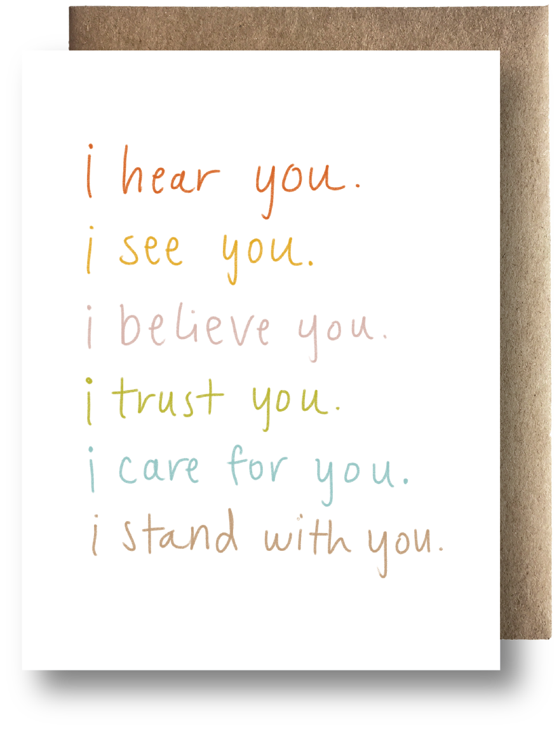
Tip 1:
Believe People
Notes:
Facilitator Notes:
Why?
You can use the quote by Brene Brown, “We need to dispel the myth that empathy is 'walking in someone else's shoes.' Rather than walking in your shoes, I need to learn how to listen to the story you tell about it's like in your shoes and believe you even when it doesn't match my experiences” as a conversation starter.
Believe people when they tell you about their experience/s.
Recognize that everyone has different perceptions based on their life experiences and identity.

Slide 7
How can we do it?
Check yourself
Center the other person’s experience
Don’t correct, minimize, or compare
Be curious
Listen
Accept
Notes:
Facilitator Notes:
Check yourself and notice if your lid is flipped or if you are whole brained. When your lid is flipped, your brain is looking for danger. When you are whole brained, you can be curious.
Center the other person’s experience as their truth. Your job is to understand, not to investigate. Acknowledge what you hear them say as well as noticing their non-verbal communication.
Don’t correct, minimize, or compare. You are holding space for their experience and all that they have to share about it.
Be curious. Lay your assumptions aside and learn from the person telling the story. Ask questions to find out more about where someone is coming from.
Listen to not only what is being said but how the person is saying it. If you’re not sure, summarize and ask if you got it right or missed anything.
Accept what is being said as that person’s truth.

Slide 8
Activity: small group
Each team member folds a piece of paper in half
On the left side, they write “I am…” followed by a self-identifier such as gender, age, race, etc.
On the right side, they write “but I am not…” followed by a common stereotype about that identifier.
This will result in the phrase, “I am ___, but I am not ___.
Notes:
Facilitator Notes:
In this activity, you will lead participants in an activity to self-identify and explore their stereotypes based on those identifiers.
This is best suited for groups of 3-5 people.
On the left side, each person will have their own paper where they can write down 1-5 identifiers such as gender, race, age, profession, etc.
On the right side, each person will write down a stereotype associated with the stereotype that they would like to dispel or overcome.
Remind participants that they can choose to participate in whatever capacity they desire and are able. Offer accommodations like writing the answers on a digital device if that is more comfortable.
Encourage participants to write down more than 1 option so that they are able to choose which statement/s they are comfortable sharing with the larger group.
Activity Tools:
Small or Large group discussion (see tips)
Resource:
12 Diversity and Inclusion activities:
https://snacknation.com/blog/diversity-inclusion-activities/

Slide 9
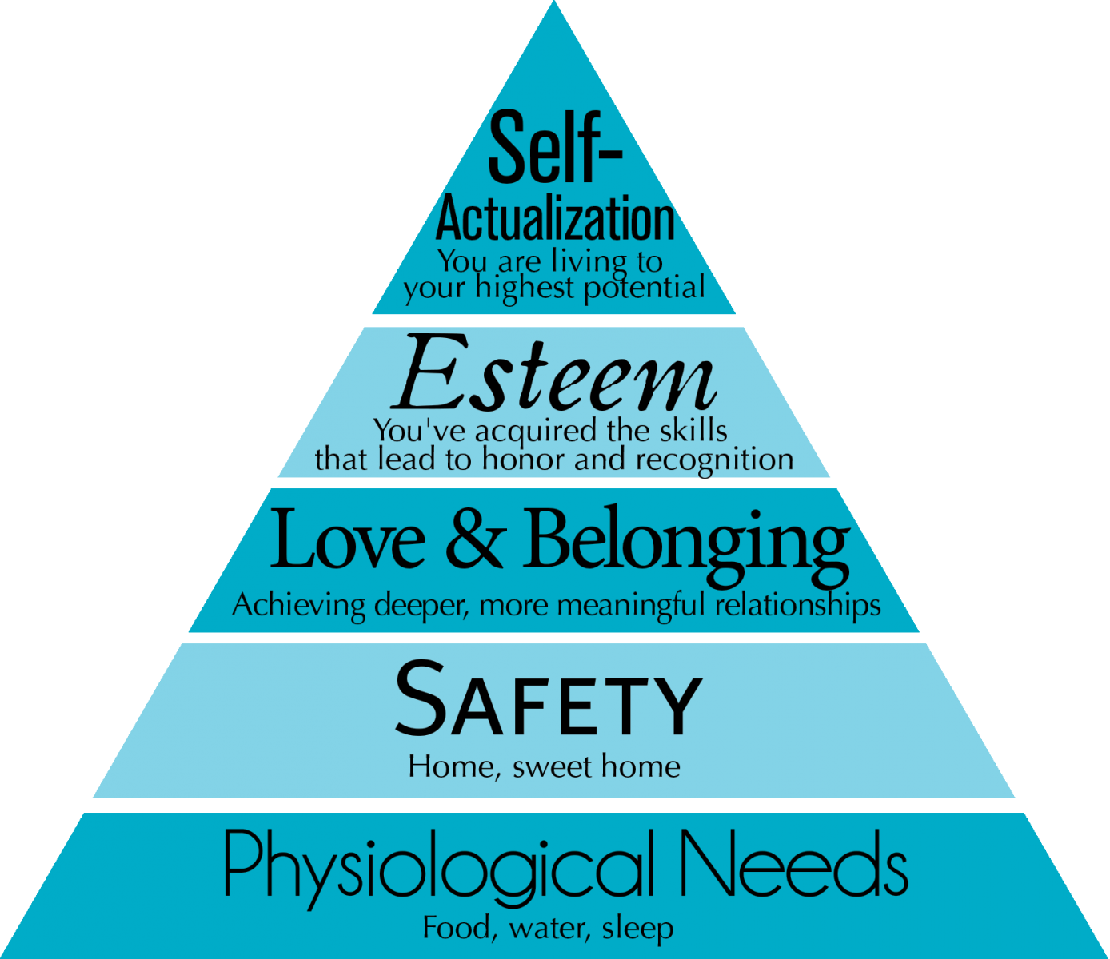
Tip 2:
Identify &
honor needs
Notes:
Facilitator Notes:
Why?
Recognizing that people’s behaviors, thoughts, and emotions are communication about an unmet need is a pillar of applying a trauma-informed approach.
To create an inclusive environment and culture, we can pause and identify what we need in the moment. Are we hungry? Tired? Lonely? Feeling out of control? Feeling Misunderstood? Unsafe? Disconnected? Alone?
When we identify needs and communicate them, we can honor them.
Resource:
Honour your needs: Helping yourself before helping others:https://joyfuldays.com/honour-your-needs/

Slide 10
How can we do it?
Create a DEIB committee
Review policies, procedures, and environment
Get feedback about people’s needs
Follow the diversity calendar
Organize a potluck
Notes:
Facilitator Notes:
Create a Diversity, Equity, Inclusion, and Belonging (DEIB) committee to learn more about the needs of the people within the organization and community from the people who are experiencing them.
Review policies, procedures, and environment. Make sure that the people who are impacted are involved in the process of identifying what is going well and what needs to change.
Get feedback about people’s needs. Find the people who are being served within the organization (both internally with employees and clients/patients) and listen to them.
Follow the diversity calendar. Holidays and observances vary from culture to culture–providing education and recognizing these days can bring people together and validate all cultures as important.
Organize a potluck. Many cultures comes together around food. Sharing food is another way to come together to share and validate different cultures.

Slide 11
Activity: large group
Identify needs that help you feel included and that you belong.
  Basic
  Psychological
  Environmental
  Communication
Notes:
Facilitator Notes:
The facilitator can guide an activity to encourage discussion on what needs they experience.
We acknowledge that each of us originates from a different place and brings their own uniqueness into the organization or community. There is strength in diversity when we can come together and form a team.
It may be helpful to provide an example from your personal experience. For example, for a member of the LGBTQ+ community, a rainbow flag might signal safety. For a person with a disability, an accessibility ramp may be needed.
The prompt can include things that fall under “basic needs” like food, shelter and also “psychological needs” like safety, control, predictability, lots of communication, etc. It can also refer back to an office setting and may elicit opposites like quiet room or music, bright lights or darkness, or community or alone time.
Depending on time, a large group discussion or activity can help achieve the goal of understanding what some understanding this principle as defined by the group.
The information collected can be used in the email sequence and shared with participants.
Activity Tools:
Google jamboard: https://jamboard.google.com/
Menti: https://www.mentimeter.com/
Large group discussion (see tips)

Slide 12
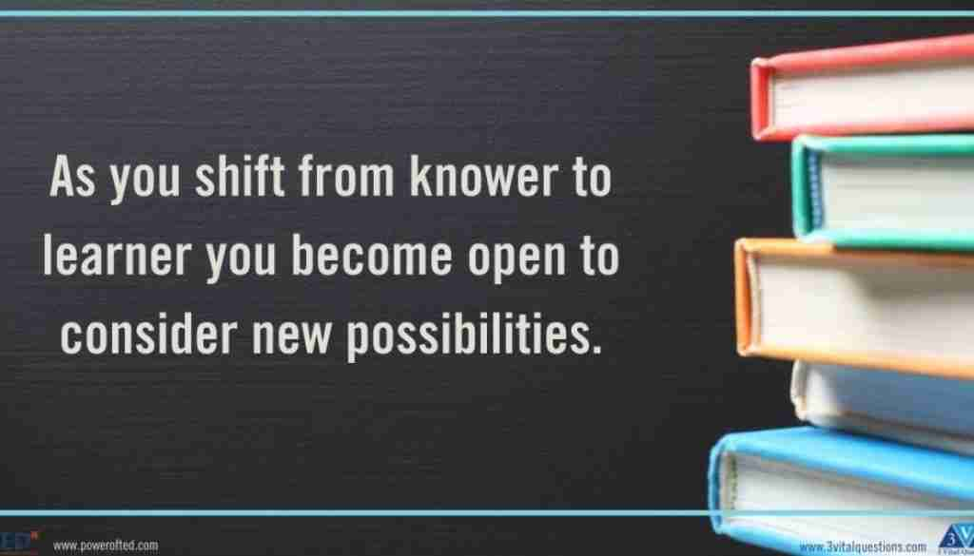
Tip 3:
Be a learner,
not a knower
Notes:
Facilitator notes:
Why?
Cultural humility is the practice of knowing that you don’t know about someone else’s experiences.
The quote, “As you shift rom knower to learner, you become open to consider new possibilities” can be a conversation starter for participants.
You can define a learner as someone who has an open mind or a “beginner’s mind” in contrast to a knower as someone who believes that they already know everything about a topic or have the correct answer or are doing things the right way.
There is often more than we can process in our first observation of a situation. This tip encourages us to zoom out and notice, with a non-judgemental lens, what we notice so that we can learn.

Slide 13
How can we do it?
Practice humility
Listen to people’s experience
Be curious
Notes:
Facilitator Notes:
Practicing humility requires that we set aside what we think we know and be open to the idea that someone else’s experience may different from our own.
When listening to another person share their experience, we may be inclined to compare, judge, or decide based on our own experience. Being a learner means listening with an open mind and observing nonjudgmentally to what is being said and how it is being communicated.

Slide 14
Activity: role play
Three people: speaker, listener, observer
Speaker: Share a recent experience that stood out to you from your personal or professional life where you did not feel included.
Listener: Use “what,” “when,” “where,” or “how” questions to learn more about the experience.
Observer: Observe
Notes:
Facilitator Notes:
In this activity, you will separate into groups of 3–a speaker, listener, and observer.
The speaker will share a recent experience that stood out to you from your personal or professional life where you did not feel included.
The listener will practice humility by using “what, when, where, or how” questions to learn more about the experience.
The observer can share their experience once the activity has concluded.
Participants will role play as a speaker, listener, and observer. If time allows, participants can rotate roles.

Slide 15
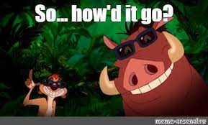
Tips for Cultural, Gender & Historical Humility recap
Tip 1: Believe people
Tip 2: Identify & honor needs
Tip 3: Be a learner, not a knower
Notes:
Facilitator Notes:
This slide summarizes the three tips for this principle.

Slide 16


Identify at least one specific practice to sprinkle
Notes:
Facilitator Notes:
The facilitator can guide an activity to encourage discussion on one practice that they can put into action to increase safety.
The information collected can be used in the next workshop to check-in with staff about their experience and practice.
Activity Tools:
Google jamboard: https://jamboard.google.com/
Menti: https://www.mentimeter.com/
Large group discussion (see tips)

Slide 17


For more information visit: originstraining.org
or email info@originstraining.org

