Slide 1
Tips for Strengths-Based
Andi Fetzner, PsyD
Lori Chelius, MBA/MPH
Co-founders, Origins Training & Consulting
Notes:
Facilitator Notes:
You may want to start with a connection activity. If the workshop is virtual, a “share-in-the-chat” can help set the tone for connection and interaction.
Facilitator can provide an introduction of themself and invite participants to share.
Depending on size of group, you might want to consider having participants break into small groups for introductions.
Share the overall goal of the workshop and offer context within which it is being provided.
Resources:
Facilitator Guide
Priya Parker- The Art of Gathering: How We Meet and Why It Matters- https://www.priyaparker.com/book-art-of-gathering

Slide 2

What to expect
  Workshop structure
    Define principle
    3 tips
      Why?
      Example
      Engagement/practice
  Supporting emails
Notes:
Facilitator Notes:
Creating predictability by providing an overview of workshop structure is one way to create safety.
Each workshop focuses on one trauma-informed principle and follows a similar format. This structure includes:
A definition of the principle. In addition to offering a formal definition, you can invite participants to share what that principle means to them.
Three practical tips to support the implementation of that principle. Each tip will include an exploration of why that tip supports the principle, examples of how to put the tip into action, and an activity to allow participants to practice implementing the tip.
Once the workshop has concluded, participants will receive an email or an email series with the content to create sustainable culture change and encourage implementation.

Slide 3
Principles of a trauma-informed approach
1. Safety
2. Trustworthiness & transparency
3. Peer support & mutual self-help
4. Collaboration & mutuality
5. Empowerment, voice, & choice
6. Strengths-based
7. Cultural, Historical, & Gender Humility
Adapted from SAMHSA
Notes:
Facilitator Notes:
This slide expands on a trauma-informed approach by reviewing SAMHSA’s trauma-informed principles. These principles can help you apply the key concepts of toxic stress, trauma, and resilience to the real world.
These principles apply both externally in terms of patient care and also internally in the organization.
A trauma-informed approach is rooted in culture and is not a checklist of activities. These principles serve as the foundation for creating that culture and help you put many of the concepts in this training into action.
Organizations can also adopt a trauma-informed approach to include the integration of trauma-informed principles. An example of this would be employee celebrations to support culture-building, hiring people from the communities they serve, time off for mental health, or even just starting meetings with a mindfulness practice.
You can learn more about each these principles in SAMHSA’s Concept of Trauma and Guidance for a Trauma-Informed Approach.
Resource:
SAMHSA’s Concept of Trauma and Guidance for a Trauma-Informed Approach: https://store.samhsa.gov/sites/default/files/d7/priv/sma14-4884.pdf

Slide 4
Strengths-based
Strengths-based approach centers the strengths and resilience of people, communities, and their environments in building a trauma-informed culture. Rather than viewing adaptations to life experiences as problems, they are seen as solutions and part of the journey toward healing.
Notes:
Facilitator Notes:
This definition explains strengths-based approach as one that considers the person before the problem.
You may want to highlight the concept of looking at the way in which a problem might be seen as an adaptive solution. For example, for some people, smoking can provide a solution to an underlying need for socialization. Healthy social connections regulate the stress response.
Identifying the sources of resilience and encouraging them to do more of what is working rather than needing to create new practices supports sustainable healing.
Be aware of your own biases and tendencies as you practice a strengths-based approach.
As with all of the principles, you may want to remind participants that the principles applies both externally in terms of patients care and also internally within the organization.

Slide 5
What does strengths-based mean to you?
Notes:
Facilitator Notes:
The facilitator can guide an activity to encourage discussion on what strengths-based means to participants. See activity tools for support.
Depending on time, a large group discussion or activity can help achieve the goal of understanding this principle as defined by the group.
The information collected can be used in the email sequence and shared with participants.
Activity Tools:
Google jamboard: https://jamboard.google.com/
Menti:https://www.mentimeter.com/

Slide 6
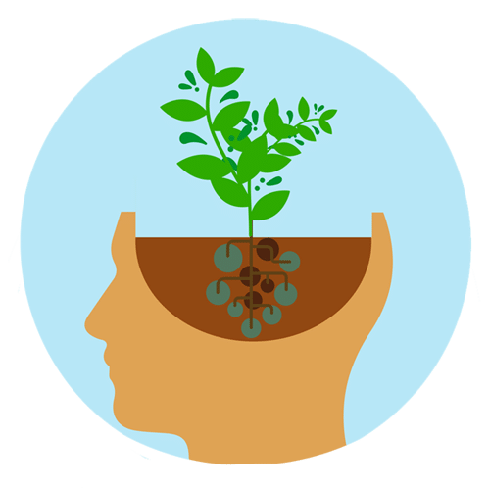
Tip 1: Practice a growth mindset
Notes:
Facilitator Notes:
Why?
There was a time when we believed that our minds were only able to learn so much before becoming stuck in a sort of automatic mode of operating.
Neuroplasticity–the ability of the nervous system to change its activity in response to learning even after injuries or traumatic experiences–teaches us that you can teach an old dog new tricks. When we rewire the brain, we can create new habits.
Carol Dweck, the founder of a growth mindset, explains that people who practice this approach to life “embrace challenges because they believe that they can learn from experiences, develop their skills, and improve with practice – all of which can lead to greater achievement.”
Resources:
What is neuroplasticity?- https://www.youtube.com/watch?v=ELpfYCZa87g
Carol Dweck Mindtools- https://www.mindtools.com/asbakxx/dwecks-fixed-and-growth-mindsets

Slide 7
How can we do it?
Make mistakes (and learn from them)
Harness the power of “yet”
Seek feedback
Try something new
Be kind to yourself
Keep going even when it’s hard
Celebrate others’ successes
Don’t compare yourself with others
Notes:
Facilitator Notes:
Make mistakes (and learn from them). Mistakes are a necessary part of the learning process.
Harness the power of “yet”: Remember that there was a time when you hadn’t learned to walk, talk, or read yet.
Seek feedback: Ask others about what they notice so that you can learn from different perspectives and listen to suggestions from their point of view.
Try something new: The best way to break an old habit is to try something new
Be kind to yourself: Learning is a process. We strive for progress, not perfection.
Keep going even when it’s hard: When a muscle is sore, it’s growing. Similarly, we experience discomfort when we are learning something new. Keep moving, even if it’s slowly. Mastery takes time and practice.
Celebrate others’ successes: We can also learn from other people’s experiences. Celebrating other people’s successes offers us the chance to recharge and see the reward we are striving for in the process of learning.
Don’t compare yourself with others: Everyone learns at a different speed and in different ways. Your attention is better served focusing on what is working for you and what you can continue to do to achieve your goals.

Slide 8
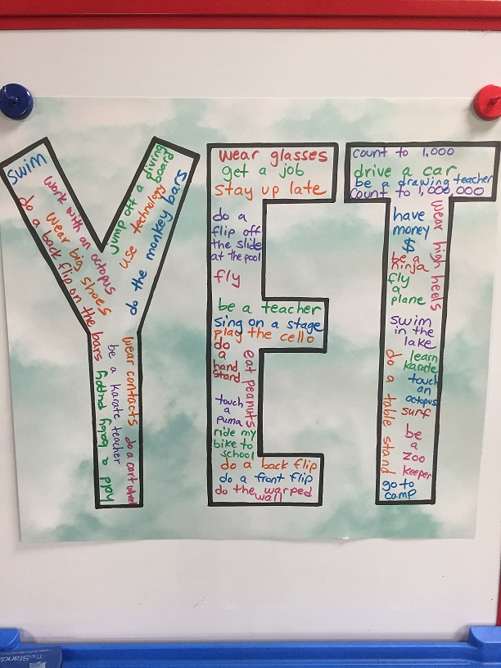
Activity: large group
Identify one thing that you haven’t achieved “YET”
Notes:
Facilitator Notes:
You can share something and offer an example of something you are considering learning more about or are currently in the process of learning (a language, a sport, a hobby, etc).
This can be an opportunity to lighten up the workshop and introduce some fun. This can help regulate the group and create connection.
This activity can also help the team learn more about one another. Encourage people to find similarities and to celebrate as they share what they haven’t learned “Yet”
Activity Tools:
Google jamboard: https://jamboard.google.com/
Menti: https://www.mentimeter.com/
Large group discussion (see tips)

Slide 9
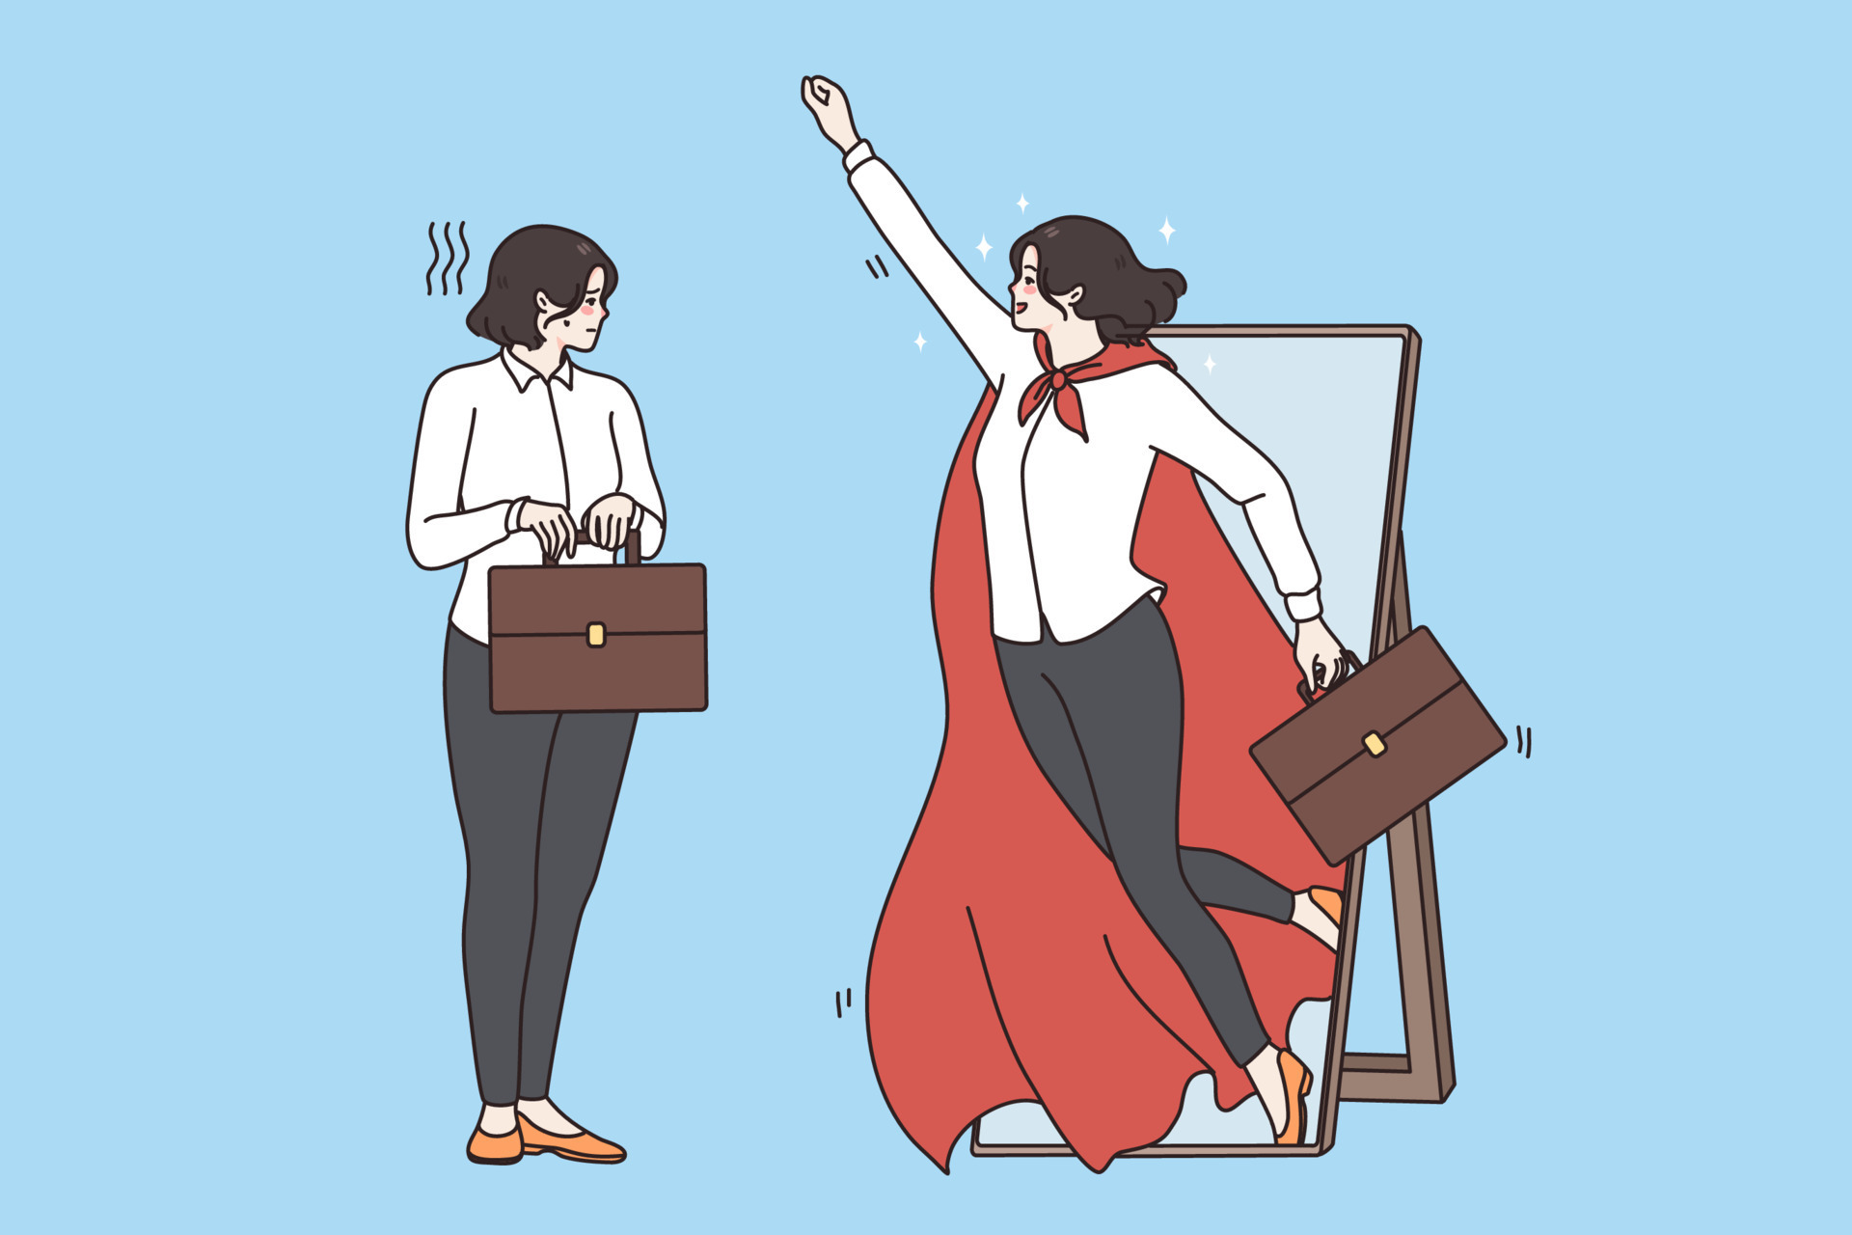
Tip 2:
Know your
superpower!
Notes:
Facilitator Notes:
Why?
Consider the quote (not by Einstein) that says, “Everybody is a genius. But if you judge a fish by its ability to climb a tree, it will live its whole life believing that it is stupid.”
Each of us is built with a unique set of skills. When we learn what those skills are and spend our time and attention on developing them, we can live our purpose.
Owning your superpower allows your to offer support to others and ask other people for help. We can connect with people in the special way that we know how.

Slide 10
How can we do it?
Know it
Embrace it
Do it
Notes:
Facilitator Notes:
You may want to identify your own superpower and share an example of how you have learned (or are in the process of learning) how to do it.
Know it. Learning what your superpower is can take a lifetime. Often we realize what it isn’t before we realize what it is. It can be a process of trial and error but once we know it, things seem easy.
Embrace it. We don’t get to choose our superpower. Of course we can practice a skill and get good at doing that skill but a superpower is something more than that. It is aligned with your purpose and is something that you can’t not do. Once you know it, embracing it is the next step.
Do it. All that’s left is for you to put on your superperson cape and to do what you were put on this Earth to do.
Resource:
Sensitivity can be a superpower- https://hbsp.harvard.edu/product/H07KV7-PDF-ENG
Discover your superpower at work- https://www.forbes.com/sites/dedehenley/2021/03/07/discover-your-superpower-at-work/?sh=75ba65627213

Slide 11
Activity: small groups
Identify your superpower (what it might be)
What is it? When was it helpful in a team? How did it change things?
How has knowing it, embracing it, and doing it changed your life?
Notes:
Facilitator Notes:
In this activity, you will lead participants in identifying their superpower and exploring how knowing it, embracing it, and doing it has helped them.
Some people might still be in the process of learning about their superpower and aren’t sure about it yet (notice the growth mindset). That’s ok! Encourage them to reflect on what it might be and to listen to others who have been through the process.
Send participants to small group breakouts to explore the questions
Remind participants that they can choose to participate in whatever capacity they desire and are able.
Invite 1-2 participants to share in the large group

Slide 12

Tip 3: Recognize others’ strengths
Notes:
Facilitator Notes:
Knowing what you do well is one piece of the puzzle. Identifying the strengths and superpowers of those around you is the next step.
Recognizing what other people are good at can help optimize your team.
When we outwardly recognize the strengths of others, we encourage them to continue to develop that skill and become masters in their own craft.

Slide 13
How can we do it?
Observe nonjudgmentally
Recognize biases or fears
Focus on the sparkle
Acknowledge and appreciate
Notes:
Facilitator Notes:
How can we do it?
Observe nonjudgmentally: Notice the strengths of others by observing what makes them smile, light up, and get excited.
Recognize biases or fears: Life has given us experiences that color how we see the world today and can set us up to look at things negatively or from a place of fear.
Focus on the sparkle: Focus on the smiles, the positive attitudes, the ways that people shine. We all have a light to us when we are living out purpose.
Acknowledge and appreciate: When you see someone practicing their superpower, acknowledge and appreciate them.

Slide 14
Activity: small groups
Write your name in the center of a blank sheet of paper.
In your group, each person team member will share a work-related strength or characteristic they value in the as a team member whose name is on the sheet. You can do this via chat or in round-robin format. (Length is no more than one sentence and as little as one word).
Once everyone is done, each participant can share any one item that surprised them or that they want to remember.
Notes:
Facilitator Notes:
In this activity, you will lead participants in recognizing one another's’ strengths.
This can be done virtually or in person.
Send participants to small group breakouts (3-4 participants) where they will share the strengths that they see in one another
Remind participants that they can choose to participate in whatever capacity they desire and are able.
Invite 1-2 participants to share in the large group

Slide 15

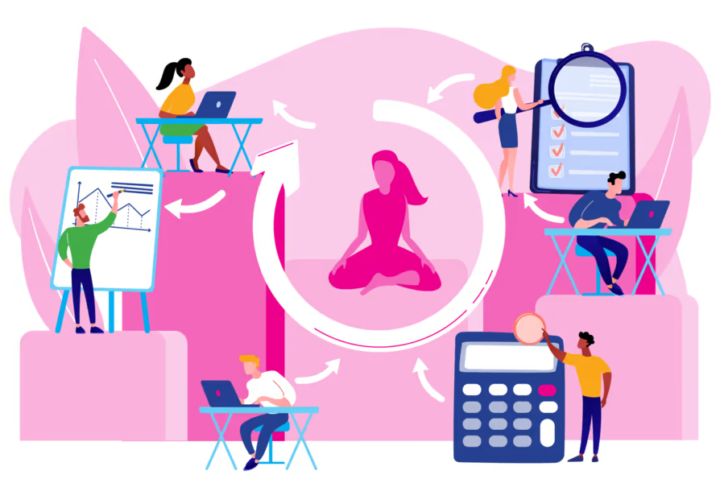
Identify at least one specific practice to sprinkle
Notes:
Facilitator Notes:
The facilitator can guide an activity to encourage discussion on one practice that they can put into action to increase safety.
The information collected can be used in the next workshop to check-in with staff about their experience and practice.
Activity Tools:
Google jamboard: https://jamboard.google.com/
Menti: https://www.mentimeter.com/
Large group discussion (see tips)

Slide 16

Strengths-based recap
Tip 1: Practice a growth mindset
Tip 2: Know your superpower
Tip 3: Recognize others’ strengths
Notes:
Facilitator Notes:
This slide summarizes the three tips for this principle.

Slide 17


For more information visit: originstraining.org
or email info@originstraining.org

