Slide 1
Tips for Empowerment, Voice, & Choice
Andi Fetzner, PsyD
Lori Chelius, MBA/MPH
Co-founders, Origins Training & Consulting
Notes:
Facilitator Notes:
You may want to start with a connection activity. If the workshop is virtual, a “share-in-the-chat” can help set the tone for connection and interaction.
Facilitator can provide an introduction of themself and invite participants to share.
Depending on size of group, you might want to consider having participants break into small groups for introductions.
Share the overall goal of the workshop and offer context within which it is being provided.
Resources:
Facilitator Guide
Priya Parker- The Art of Gathering: How We Meet and Why It Matters- https://www.priyaparker.com/book-art-of-gathering

Slide 2

What to expect
  Workshop structure
    Define principle
    3 tips
      Why?
      Example
      Engagement/practice
  Supporting emails
Notes:
Facilitator Notes:
Creating predictability by providing an overview of workshop structure is one way to create safety.
Each workshop focuses on one trauma-informed principle and follows a similar format. This structure includes:
A definition of the principle. In addition to offering a formal definition, you can invite participants to share what that principle means to them.
Three practical tips to support the implementation of that principle. Each tip will include an exploration of why that tip supports the principle, examples of how to put the tip into action, and an activity to allow participants to practice implementing the tip.
Once the workshop has concluded, participants will receive an email or an email series with the content to create sustainable culture change and encourage implementation..

Slide 3
Principles of a trauma-informed approach
1. Safety
2. Trustworthiness & transparency
3. Peer support & mutual self-help
4. Collaboration & mutuality
5. Empowerment, voice, & choice
6. Strengths-based
7. Cultural, historical, & gender humility
Adapted from SAMHSA
Notes:
Facilitator Notes:
This slide expands on a trauma-informed approach by reviewing SAMHSA’s trauma-informed principles. These principles can help you apply the key concepts of toxic stress, trauma, and resilience to the real world.
These principles apply both externally in terms of patient care and also internally in the organization.
A trauma-informed approach is rooted in culture and is not a checklist of activities. These principles serve as the foundation for creating that culture and help you put many of the concepts in this training into action.
Organizations can also adopt a trauma-informed approach to include the integration of trauma-informed principles. An example of this would be employee celebrations to support culture-building, hiring people from the communities they serve, time off for mental health, or even just starting meetings with a mindfulness practice.
You can learn more about each these principles in SAMHSA’s Concept of Trauma and Guidance for a Trauma-Informed Approach.
Resource:
SAMHSA’s Concept of Trauma and Guidance for a Trauma-Informed Approach: https://store.samhsa.gov/sites/default/files/d7/priv/sma14-4884.pdf

Slide 4
Empowerment, voice & choice
“Throughout the organization and among the clients served, individuals’ strengths and experiences are recognized and built upon. The organization fosters a belief in the primacy of the people served, in resilience, and in the ability of individuals, organizations, and communities to heal and promote recovery from trauma. The organization understands that the experience of trauma may be a unifying aspect in the lives of those who run the organization, who provide the services, and/ or who come to the organization for assistance and support. As such, operations, workforce development and services are organized to foster empowerment for staff and clients alike. Organizations understand the importance of power differentials and ways in which clients, historically, have been diminished in voice and choice and are often recipients of coercive treatment. Clients are supported in shared decision-making, choice, and goal setting to determine the plan of action they need to heal and move forward. They are supported in cultivating self-advocacy skills. Staff are facilitators of recovery rather than controllers of recovery. Staff are empowered to do their work as well as possible by adequate organizational support. This is a parallel process as staff need to feel safe, as much as people receiving services.”
Source: SAMHSA (2018)
Notes:
Facilitator Notes:
This definition is from the Substance Abuse and Mental Health Services Administration.
You may want to highlight the concept of power differentials within a system’s structure. An example of this is physicians, administration staff, and executive leadership.
Identifying and encouraging past experiences that may be barriers to putting this principle into practice can be acknowledged here.
Exploring each person’s role within the clinic and identifying the necessity of each can help support this principle.
As with all of the principles, you may want to remind participants that the principles applies both externally in terms of patients care and also internally within the organization.
Resource:
SAMHSA’s Concept of Trauma and Guidance for a Trauma-Informed Approach: https://store.samhsa.gov/sites/default/files/d7/priv/sma14-4884.pdf

Slide 5
What does empowerment, voice, & choice mean to you?
Notes:
Facilitator Notes:
The facilitator can guide an activity to encourage discussion on what empowerment, voice, & choice mean to participants. See activity tools for support.
Depending on time, a large group discussion or activity can help achieve the goal of understanding this principle as defined by the group.
The information collected can be used in the email sequence and shared with participants.
Activity Tools:
Google jamboard: https://jamboard.google.com/
Menti: https://www.mentimeter.com/

Slide 6

“The people who face the problems
every day are the ones who hold the
key to their answer.”
Source: Human Centered Design
Notes:
Facilitator Notes:
Note the practice of including the people who decisions impact in the process because the people experiencing the problems are the ones who know what needs to change.
The phrase, “Nothing about us without us” can be a conversation starter for participants.
This concept is taken from human-centered design.
You are encouraged to share examples to bring this concept to life from your own experience.

Slide 7

Tip 1:
Be curious
Notes:
Facilitator Notes:
Why?
Developing the skill of curiosity helps us overcome our automatic biases of others and can help us stay out of judgment.
A non-judgmental environment helps create a culture where people want to communicate their experiences with each other.
This also creates a more inclusive environment where people and relationships are the most important asset and everyone is an expert.

Slide 8
How can we do it?
Practice being in awe and wonder of the world
Embrace the fear of trying something new
Ask “what,” “when,” “where,” or “how” questions
Don’t take anything personally
Observe others
Take risks to and try new experiences
Notes:
Facilitator Notes:
Sit in awe and wonder of the world. Practice a beginner’s mind. Engage your senses and notice the world as if you have never experienced it before.
Embrace the fear of trying something new. Ask “is this fear true”?
Ask questions that lead with “what,” “when,” “where,” or “how” to learn more about how other people experience the world.
Don’t take things personally. Lead with “what’s going on with them?” instead of “what’s wrong with them?”
Observe others to learn about how they are experiencing the world. Notice what you see in how they are responding to the world and note any similarities and differences to what you’ve experienced.
Take risks to and try new experiences. Learn something new. Expose yourself to opportunities to try new things, meet new people, eat different foods, listen to different music.
Resource:
Empowering yourself with curiosity- https://www.modernhealth.com/post/how-to-empower-yourself-with-curiosity-the-super-skill

Slide 9
Activity: role play
Three people: speaker, listener, observer
Speaker: Share a recent experience that stood out to you from your personal or professional life.
Listener: Use “what,” “when,” “where,” or “how” questions to learn more about the experience
Observer: Observe
Notes:
Facilitator Notes:
In this activity, the goal is to practice being curious using “what,” “when,” “where,” or “how” questions.
Participants will role play as a speaker, listener, and observer. If time allows, participants can rotate roles.
Remind participants that this is not an actual emergency situation where anyone’s life or safety is in danger, although the patient/colleague role will act as though it is.
The observer can share their experience once the activity has concluded.
Note: You may find yourself slipping into approval, disapproval, or judgement. Stick with peeling back the layers to learn more about the person’s experience.

Slide 10

Tip 2:
Offer choices
(but not too many)
Notes:
Facilitator Notes:
Why?
When we feel like we don’t have a choice, it’s disempowering.
While making decisions can be difficult at times (choosing between two unfavorable experiences), offering a choice gives space for autonomy/agency and empowerment.
Understanding brain science helps us support people as they are making decisions. When people are in a flipped lid state, they are not making a decision but rather complying with a request.
Only a whole brain can process words and make comparisons so if someone’s lid is flipped, they are not choosing their choice. This can be a re-traumatizing experience for people who have a history of disempowerment.
Understanding choice through the lens of brain science can help us help people to make decisions that are congruent with their wants and needs.
Note: Practice connection before compliance. Letting go of control and outcomes can be difficult when we want people to make the decision that is going to help them heal. Focus on the person and the relationship.
Resource:
Empowerment through Choice? A Critical Analysis of the Effects of Choice in Organizations- https://www.sciencedirect.com/science/article/abs/pii/S0191308506270023

Slide 11
How can we do it?
Regulate! (get whole-brained)
Offer choice when possible in:
  Sequence of events
  Which event
  Participation
  Timing
  Who is present at the meeting/appointment
  Location
Notes:
Facilitator Notes:
True decisions can only be made when a person is whole-brained. Otherwise, their behavior is compliance.
Sequence of events- what do you want to do first?
This or that- offer options that are within the scope of what will keep the person safe
To participate or not- a person can decide whether to participate or not and if so, how much and in what way
Timing: AM/PM meetings, how long something is, get out early
Who is present at the meeting/appointment- considerations of the clinic’s policy. Communicate expectations beforehand>
Location: Where do you want to work? Fill out paperwork?
Encourage participants to share examples of how they can practice this in the clinic setting
Resource:
Trauma-informed care (TIC) best practices for improving patient care in the emergency department-
https://www.ncbi.nlm.nih.gov/pmc/articles/PMC10197231/#:~:text=Trauma%2Dinformed%20approaches%20to%20procedures,the%20patient's%20concerns%20and%20preferences

Slide 12
Activity: Would you rather?
Kangaroo or frog?
Spontaneous or make a plan?
Mountains or beach?
Work independently or with a team?
Early bird or night owl?
Video call or phone call?
Lead the effort or go with the flow?
Notes:
Facilitator Notes:
In this activity, you will lead participants in choosing between two options.
You can use these examples or others. Mix fun options in with more serious options to keep participants regulated.
Provide the following guidance and model an example:
Trust your instinct
Share it with the group in the chat, in person, or using an activity tool below
The number of options shared will depend on the amount of time and the number of participants. Use your discretion.
Activity Tools:
Google jamboard: https://jamboard.google.com/
Menti: https://www.mentimeter.com/
Resource:
100 Would You Rather Questions for Coworkers- https://www.signupgenius.com/Business/would-you-rather-questions-coworkers.cfm

Slide 13
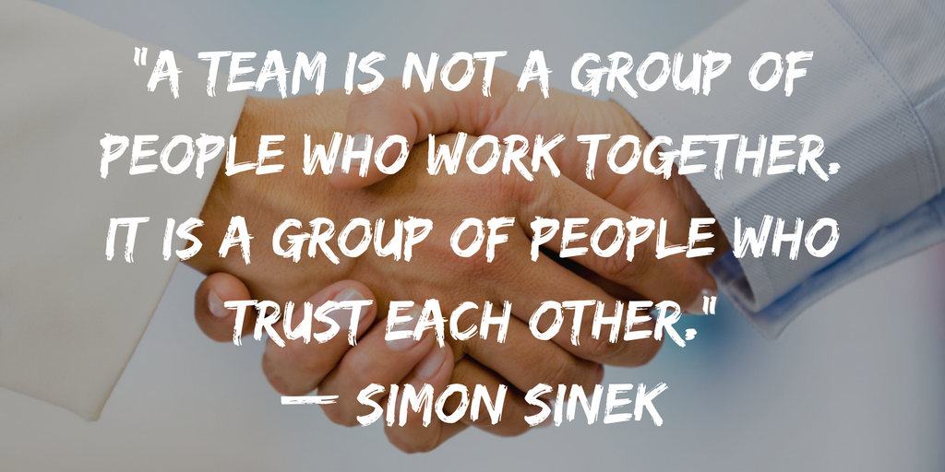
Tip 3: Trust
your people
Notes:
Facilitator notes:
Why?
When we can trust people we can be empowered to do our thing without focusing on other people.
Acknowledge barriers to trust including trauma, a person’s or group’s past behavior, and/or organizational culture.
Trust is established by finding a shared purpose, is reinforced by consistency, and is broken by the betrayal of one of these.
Rebuilding trust requires owning that the betrayal occurred and making a commitment to do something different moving forward.
The quote by Simon Sinek, “A team is not a group of people who work together. A team is a group of people who trust each other” can be a conversation starter for participants.

Slide 14
How can we do it?
Listen to people’s experience
Share responsibility
Encourage autonomy
Establish clear plans, expectations, and goals
Identify clear roles and responsibilities
Celebrate
Repair when harm is done
Notes:
Facilitator Notes:
Connection is the foundation of trust. The following are ways to connect with people in healthy ways to support trust within a team setting.
Listen to people’s experience: Ask about what an experience was like for them. Believe that what they say is true for them.
Share responsibility: Find what you are good at and what they are good at and take pieces of a project to share.
Encourage autonomy: Offer opportunities for people to do things on their own.
Clear plans, expectations, and goals. Create structure around what the plan is (after collaborating on its creation), establish expectations and goals and agree how they will be met
Identify clear roles and responsibilities: Decide who is doing what.
Celebrate: Along they way and at a project’s completion, acknowledge how the project is going and celebrate.
Repair when harm is done. Things don’t always go as planned and that is ok. If a mistake is made, take accountability and do what needs to be done to find a solution so that the error does not occur again.

Slide 15
Activity: 2 Truths & 1 Lie
Each person identifies two truths about themselves, as well as one convincing lie
In a round-robin format, each person takes turns sharing their three statements with the rest of the group without pointing out which is the lie
The group then has to guess which statement out of the three is a lie
After 3 guesses, the person reveals the lie
Notes:
Facilitator Notes:
In this activity, you will lead participants in sharing 2 truths and a lie. This can be a small or large group activity.
Start the activity by sharing your own 2 truths and a lie about yourself. Keep it light but interesting.
Remind participants that they can choose to participate in whatever capacity they desire and are able. Offer accommodations like the option to sit rather than stand.
Activity Tools:
Small or Large group discussion (see tips)

Slide 16

Empowerment, voice, & choice recap
Tip 1: Be curious
Tip 2: Offer choices (but not too many)
Tip 3: Trust your people
Notes:
Facilitator Notes:
This slide summarizes the three tips for this principle.

Slide 17


Identify at least one specific practice to sprinkle
Notes:
Facilitator Notes:
The facilitator can guide an activity to encourage discussion on one practice that they can put into action to increase safety.
The information collected can be used in the next workshop to check-in with staff about their experience and practice.
Activity Tools:
Google jamboard: https://jamboard.google.com/
Menti: https://www.mentimeter.com/
Large group discussion (see tips)

Slide 18


For more information visit: originstraining.org
or email info@originstraining.org

