Slide 1
Tips for Collaboration and Mutuality
Andi Fetzner, PsyD
Lori Chelius, MBA/MPH
Co-Founders, Origins Training & Consulting

Slide 2

What to expect
  Workshop structure
    Define principle
    3 tips
      Why?
      Example
      Engagement/practice
  Supporting emails

Slide 3
Principles of a Trauma-Informed Approach
1. Safety
2. Trustworthiness & transparency
3. Peer support
4. Collaboration & mutuality
5. Empowerment, voice, & choice
6. Strengths-based
7. Cultural, Historical, and Gender Humility
Adapted from SAMHSA

Slide 4

Peer Support Recap
Tip #1: Identify Buddies
Tip #2: Offer Appreciation
Tip #3: Find Similarities

Slide 5
Collaboration & Mutuality
Importance is placed on partnering and the leveling of power differences between staff and clients and among organizational staff from clerical and housekeeping personnel, to professional staff to administrators, demonstrating that healing happens in relationships and in the meaningful sharing of power and decision-making. The organization recognizes that everyone has a role to play in a trauma-informed approach. As one expert stated: “one does not have to be a therapist to be therapeutic.”
Source: SAMHSA (2018), https://www.cdc.gov/cpr/infographics/6_principles_trauma_info.htm

Slide 6
What do Collaboration & Mutuality mean to you?

Slide 7
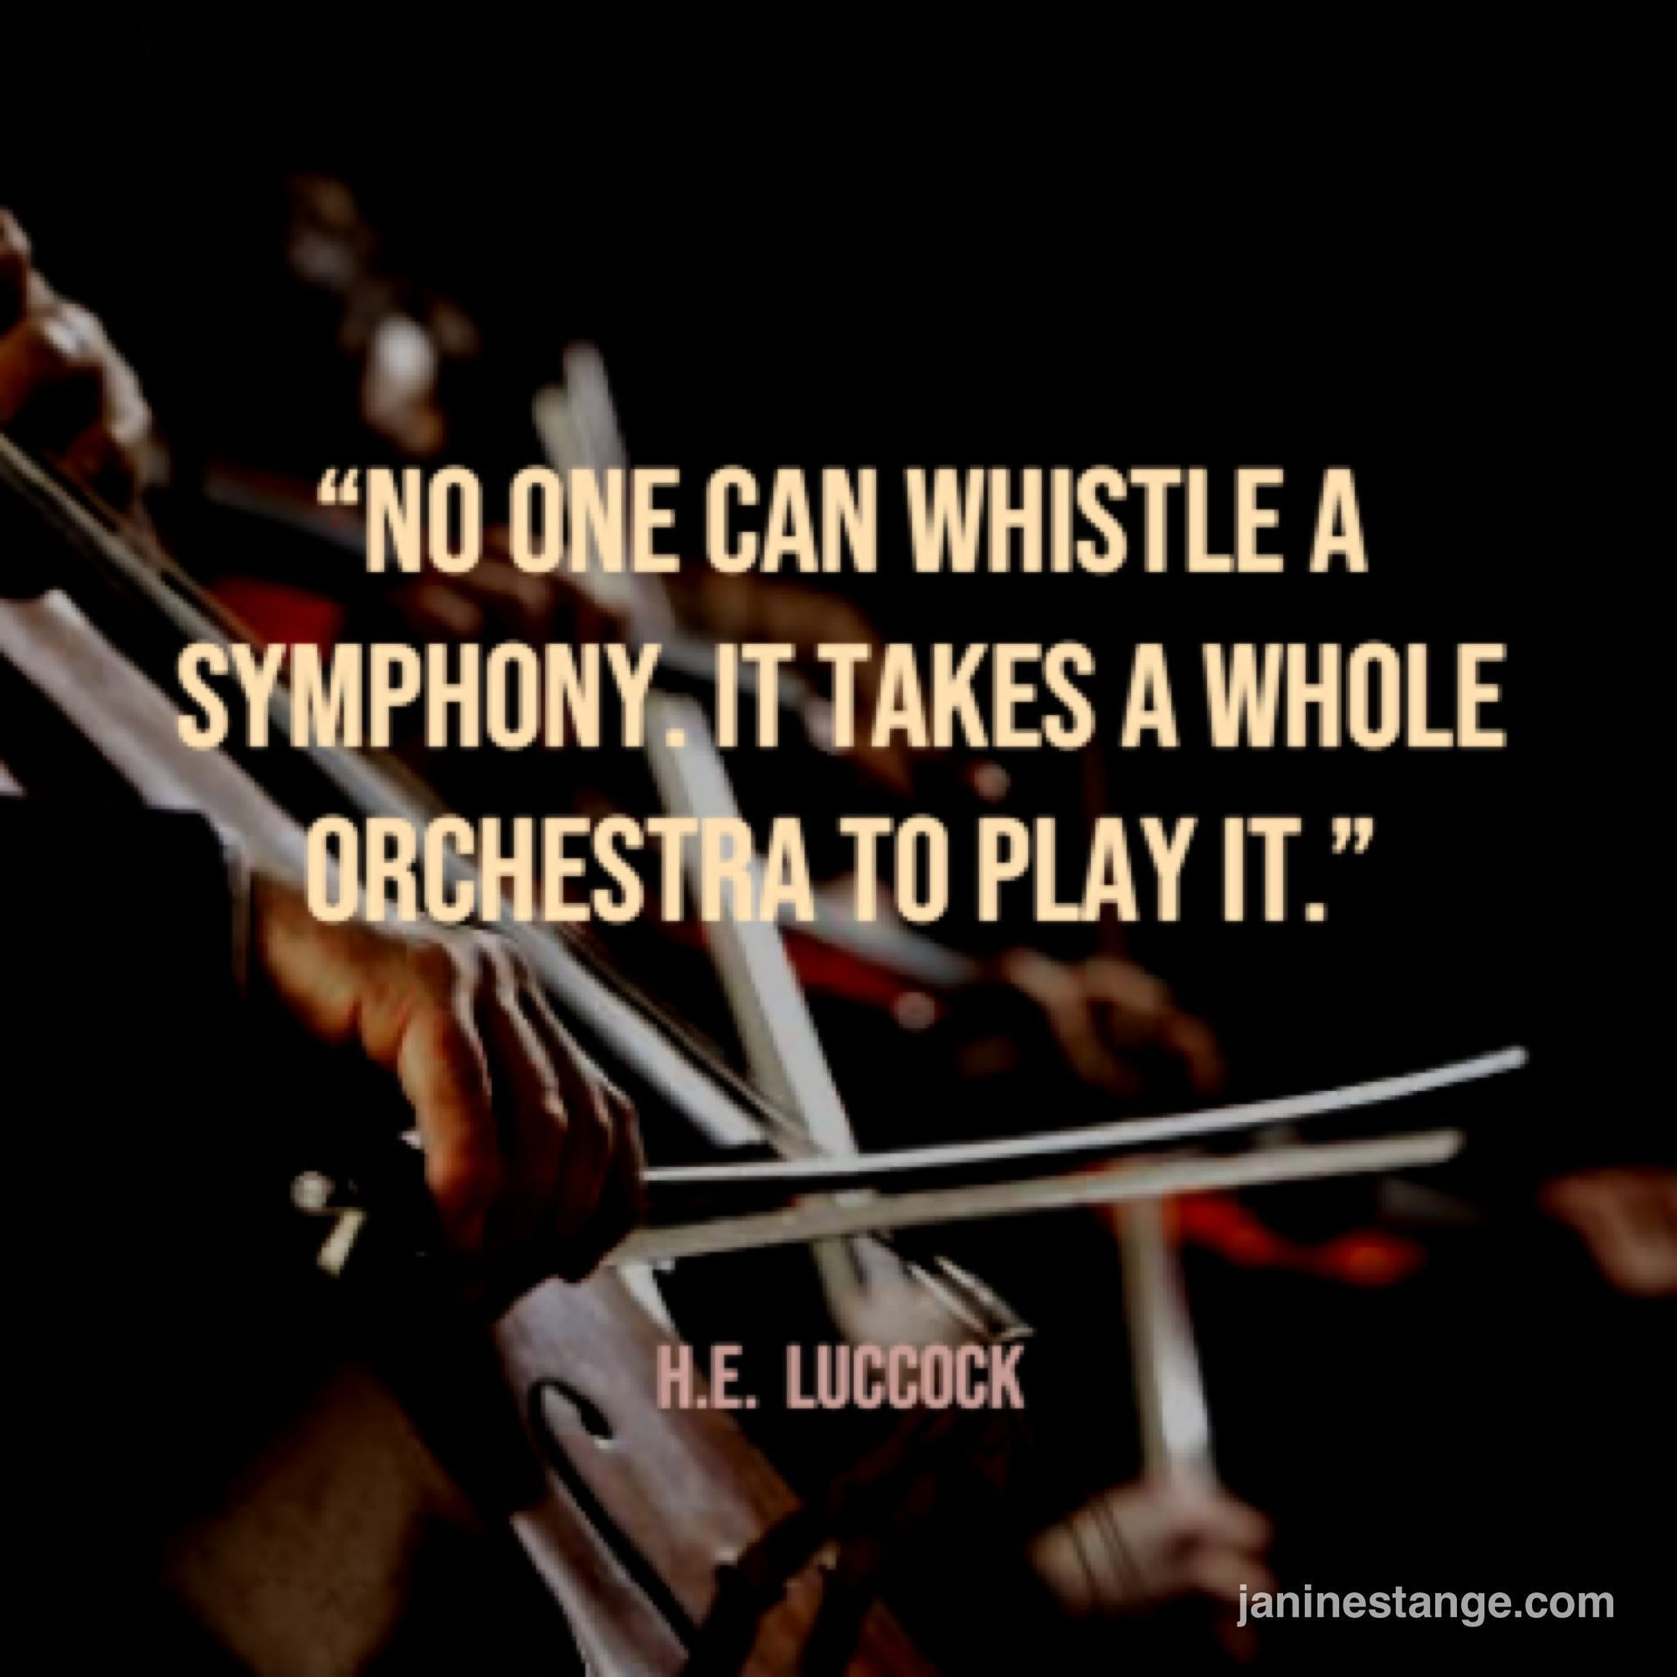
Tip #1: Emphasize
Shared Purpose

Slide 8
How can we do it?
Know your why (and share it with others!)
Make your shared purpose visible
Set collective intention in everyday activities (team huddles, meetings, etc)
Others?

Slide 9
Activity
Breakouts:
Think back to your why. What makes you sing your song?
What songs do you sing together?

Slide 10

Tip #2:
Celebrate!

Slide 11
How can we do it?
It’s Monday!
Milestones
Changes/transitions
Accomplishments
Team progress/goals

Slide 12
Activity
What’s something that you can celebrate right now?

Slide 13

Tip #3: Identify clear roles

Slide 14
How can we do it?
Create clear job descriptions
Know your team
Have a clear plan for who is doing what

Slide 15
Activity
Identify someone you collaborate well with.
Consider both of your strengths. Why do you work well together?

Slide 16

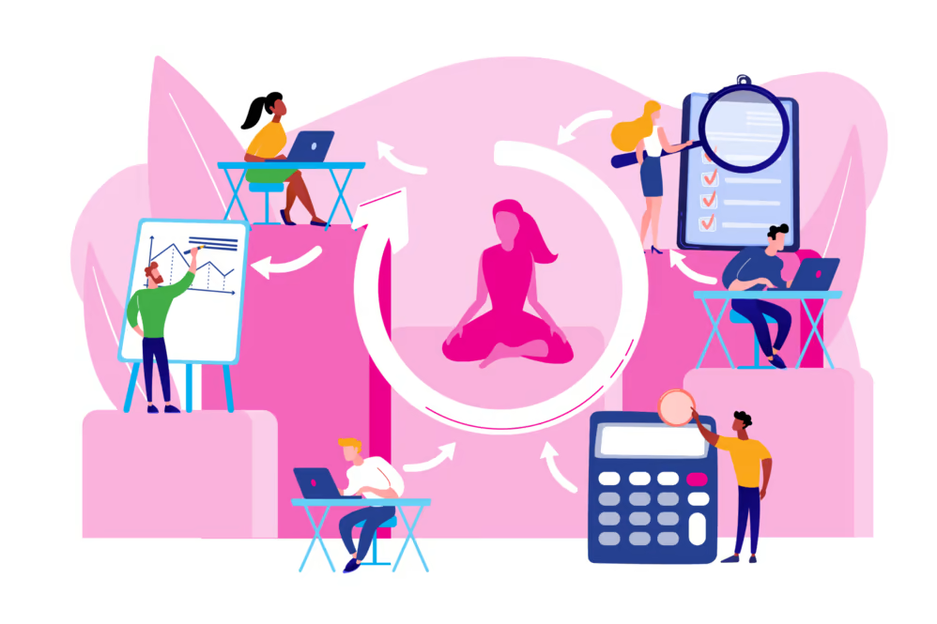
Identify at least one specific practice to sprinkle

Slide 17

For more information visit originstraining.org
or email
info@originstraining.org

