Slide 1
Tips for Trustworthiness & Transparency
Andi Fetzner, PsyD
Lori Chelius, MBA/MPH
Co-Founders, Origins Training & Consulting

Slide 2

What to expect
  Workshop structure
    Define principle
    3 tips
      Why?
      Example
      Engagement/practice
  Supporting emails

Slide 3
Principles of a Trauma-Informed Approach
1. Safety
2. Trustworthiness & transparency
3. Peer support
4. Collaboration & mutuality
5. Empowerment, voice, & choice
6. Strengths-based
7. Cultural, Historical, and Gender Humility
Adapted from SAMHSA

Slide 4

Safety recap
Tip #1: Incorporate movement
Tip #2: Set (and hold) healthy boundaries
Tip #3: Assume everyone is doing the best they can

Slide 5
Trustworthiness & Transparency
Organizational operations and decisions are conducted with transparency with the goal of building and maintaining trust with clients and family members, among staff, and others involved in the organization.
Source: SAMHSA (2018), https://www.cdc.gov/cpr/infographics/6_principles_trauma_info.htm

Slide 6
What do you associate with trustworthiness & transparency?

Slide 7
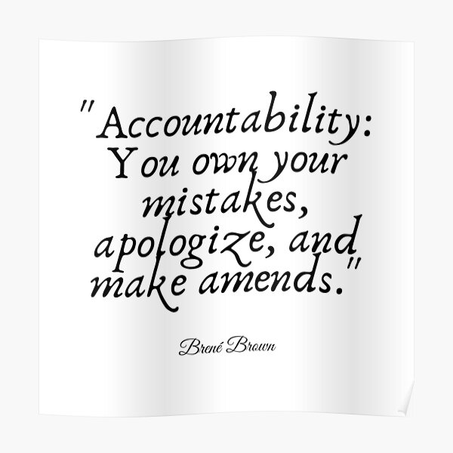
Tip #1:
Own your mistakes

Slide 8
Ingredients of a (good) apology
1. It does not include the word “but.”
2. It keeps the focus on your actions—and not on the other person’s response.
3. It includes an offer of reparation or restitution that fits the situation.
4. It does not overdo.
5. It doesn’t get caught up in who’s more to blame or who started it.
6. A true apology needs to be backed by corrective action.
7. It requires that you do your best to avoid a repeat performance.
8. Should not serve to silence others.
9. It does not ask the hurt party to do anything, not even to forgive.
Source: Harriet Lerner’s Nine Essential Ingredients of a True Apology, Unlocking Us with Brene Brown

Slide 9
Activity - role play
Three people -Staff, patient/colleague, observer
Staff: You were feeling the pressure of time to get a task finished and made a mistake (this could be forgetting to complete a patient file you were working on, snapping at a patient or colleague, not asking for help when you were feeling overwhelmed, or something else). Practice taking accountability for what happened.
Patient/colleague: You just experienced the staff member’s mistake. Your job is to listen and pay attention to what you notice in your body, emotions, and thoughts.
Observer: Observe

Slide 10

Tip #2:
Laugh!

Slide 11
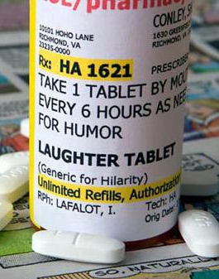
How can we do it?
Comedy commute
Three funny things
Play the “what I could’ve said” game
Five-minute funny
Follow funny

Slide 12

Activity
Pull out your phone
Look up a joke
Share with the group

Slide 13

Tip #3:
Create Predictability

Slide 14

How can we do it?
Create agendas or plans
Communicate frequently and clearly
Define clear metrics
Prioritize goals and tasks
Establish clear roles
Minimize interruptions
Answer questions and validate people
Create “predictable unpredictability”

Slide 15
Activity
Think about your role.
Identify a situation where you are working with another person who might be new or feeling uncertain about what to expect.
How can you use these examples (or others) to increase predictability (with patients, co-workers, etc)?

Slide 16


Identify at least one specific practice to sprinkle

