Slide 1
Tips for Creating Safety
Andi Fetzner, PsyD
Lori Chelius, MBA/MPH
Co-Founders, Origins Training & Consulting

Slide 2

What to expect
  Workshop structure
    Define principle
    3 tips
      Why?
      Example
      Engagement/practice
  Supporting emails

Slide 3
Principles of a Trauma-Informed Approach
1. Safety
2. Trustworthiness & transparency
3. Peer support
4. Collaboration & mutuality
5. Empowerment, voice, & choice
6. Strengths-based
7. Cultural, Historical, and Gender Humility
Adapted from SAMHSA

Slide 4
Safety
Throughout the organization, staff and the people they serve, whether children or adults, feel physically and psychologically safe; the physical setting is safe and interpersonal interactions promote a sense of safety. Understanding safety as defined by those served is a high priority.
Source: SAMHSA (2018), https://www.cdc.gov/cpr/infographics/6_principles_trauma_info.htm

Slide 5
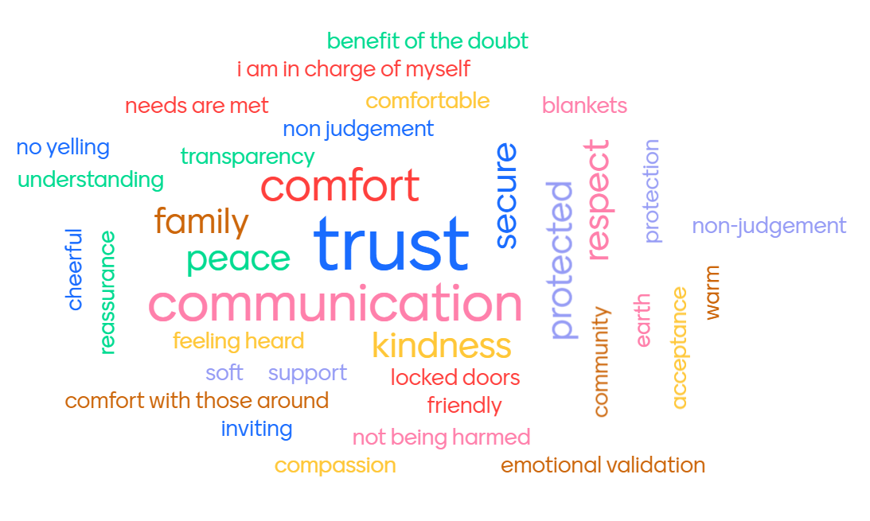
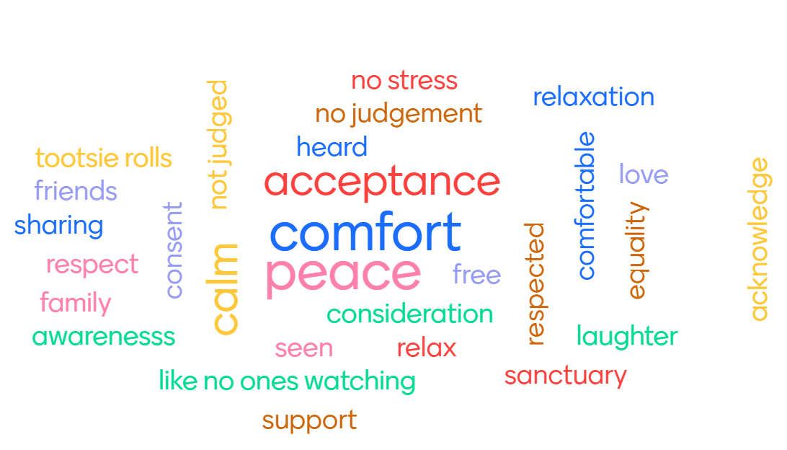
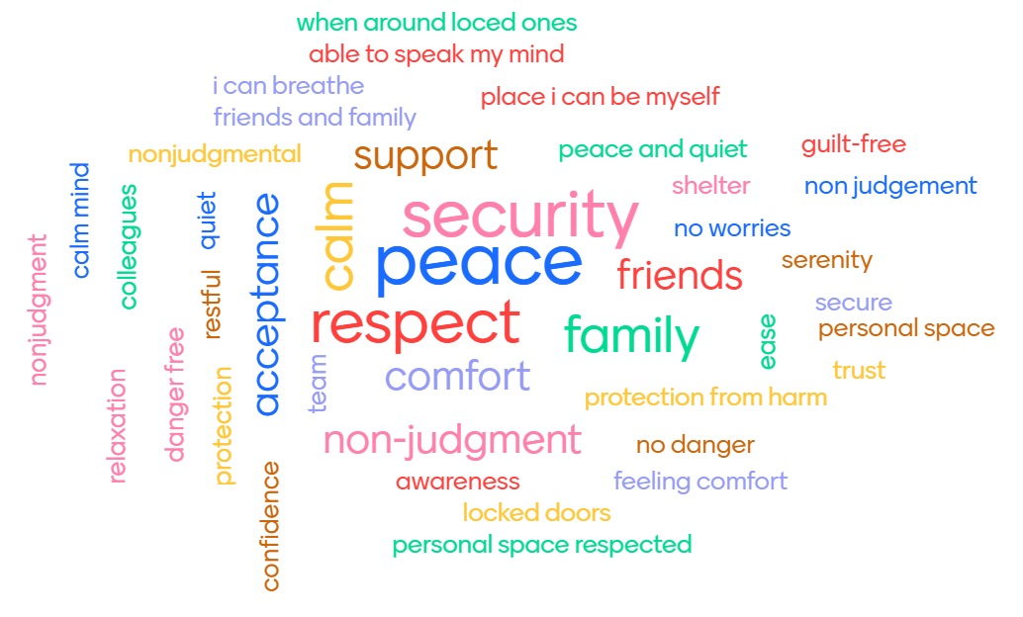

Slide 6

“Safety is not the absence of threat, it is the presence of connection.”
~Gabor Mate

Slide 7


Tip #1: Incorporate Movement

Slide 8

How can we do it?
Walking meetings
Get up and stretch (or jump around!)
Offer high 5’s, elbows

Slide 9
Activity
Count 1-8 while shaking your left hand then right hand then left foot, then right foot.
e.g.
Left hand shake - "1,2,3,4,5,6,7,8"
Right hand shake - "1,2,3,4,5,6,7,8"
...then left foot and right foot
You do the sequence again but this time count up to 7.
You repeat this decreasing every time and until the last set of 1 when you shake your whole body out.

Slide 10

Tip #2:
Set (and hold) healthy boundaries

Slide 11
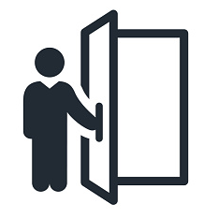
How can we do it?
Identify your boundaries
Communicate your boundaries (clear is kind)
Hold your boundaries

Slide 12
Activity
Role play - practice boundaries while maintaining connection
Three people - patient/colleague, communicare staff, observer
  Patient/colleague: (not actually emergency) You are calling to ask for an immediate appointment or are telling a colleague you need to them to send a document right away. This is very important to you. Imagine that your lid is flipped (and be a little persistent!)
  Staff: You will practice setting boundaries while maintaining connection. Remember to:
    Identify your boundaries
    Communicate your boundaries (clear is kind)
    Hold your boundaries
  Observer: observe
Notes:
12 minutes

Slide 13
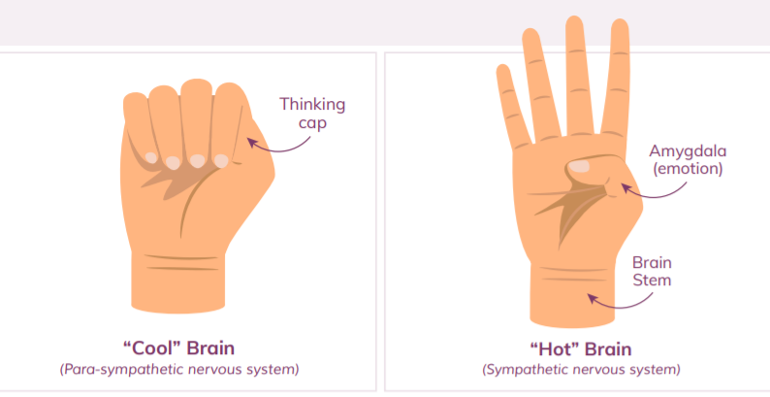

Tip #3:
Assume everyone is doing the best they can

Slide 14
Do this Don’t do this
Try to relate (...like me)
Meet them where they are (if you’re not sure, ask)
What I’m hearing you say is…
Take it personally or judge
Start in the same place for everyone
Try to immediately problem solve

Slide 15
Activity
Role play - Practice assuming everyone is doing the best they can
Three people - patient/colleague, CommuniCare staff, observer
  Patient/colleague: You are trying to finish paperwork (for yourself as a patient or as a staff member). You’ve already had a day, you can’t find a pen and now your your phone is ringing and you notice it’s your kid’s school. In a frustrated voice, you tell the staff (or your colleague) to give you a minute and that they need to wait.
  Staff: It’s the end of your day and are running behind and you need this paperwork to leave on time.
    Practice assuming everyone is doing the best they can. Remember:
      Their behavior is communication and try to relate (...like me)
      Meet them where they are at (if you’re not sure, ask)
      What I’m hearing you say is…
  Observer: observe

Slide 16

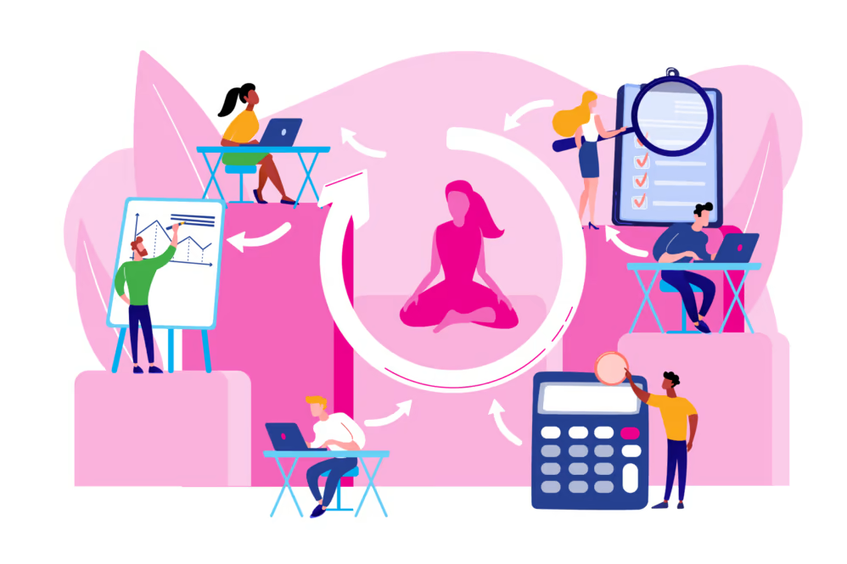
Identify at least one specific practice to sprinkle

Slide 17

For more information visit originstraining.org
or email
info@originstraining.org

